Slide 1
TOPIC: The Hazards of Moviegoing
I am a movie fanatic. When friends want to know what picture won the Oscar in 1980 or who played the police chief in Jaws, they ask me. My friends, though, have stopped asking me if I actually want to go out to the movies. The problems in getting to the theater, the theater conditions, and the behavior of some patrons are all reasons why I avoid the local movie theater.

Slide 2
TOPIC: The Benefits of Regular Exercise
In recent years, may people have become increasingly aware of the need for physical fitness. Almost everywhere people turn, advice for guarding and improving health bombards them. Although much of this advice is commercially motivated to sell vitamins and natural foods, utilizing a regular exercise program is important. Using such a program, if it consists of at least thirty minutes three times a week, provides numerous benefits. Regular exercise releases tension, improves appearance, and increases stamina.

Slide 3
TOPIC: Keys to a Successful Essay
Many students find essay writing difficult and frustrating. They know what they want to say, but when it comes to expressing themselves through writing, they encounter problems. Not only do they have to address the points of their topic, they also have to follow the conventions of the formal academic essay. The task seems daunting. Broken down into its basic components, however, essay writing is not so difficult. In fact, by addressing three key elements, every student can write an effective essay. These key elements are focus, organization, and clarity.

Slide 4
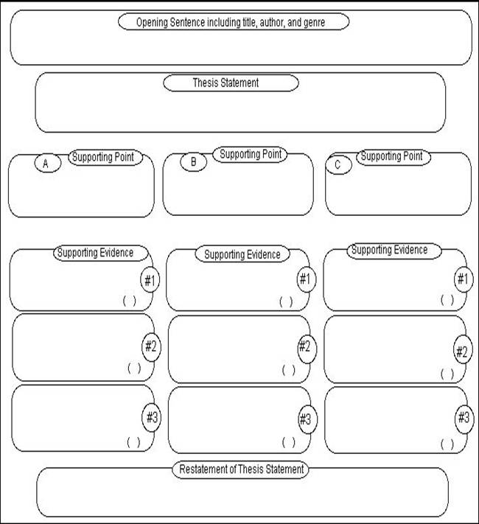

Slide 5
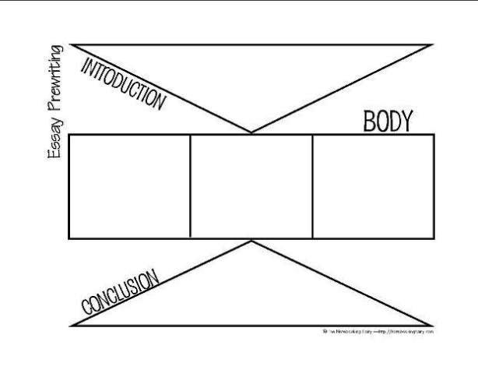

Slide 6
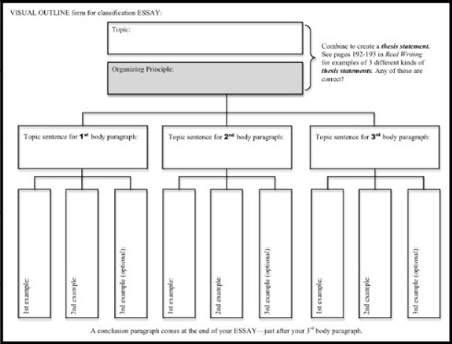

Slide 7
