Slide 1
The Giver
Novel Genre:
Dystopia
Utopia
Science Fiction
© Presto Plans

Slide 2
Dystopia
a fictional society that is in some important way undesirable or frightening
are often characterized by:
-dehumanization
-totalitarian governments
-environmental disaster
-decline in society.
-technology vs. humanity
© Presto Plans

Slide 3
Dystopia
Dystopian fiction is often used to raise real-world concerns that may become present in the future. For example:
Pollution
Poverty
Political Repression
Totalitarianism
© Presto Plans

Slide 4
Your Turn!
Can you name any other movies, TV shows, or novels that use the dystopia genre?
© Presto Plans

Slide 5
Utopia
utopia is the opposite of a dystopia
contains a society possessing highly desirable or perfect qualities
© Presto Plans

Slide 6
Your Turn!
Can you name any other movies, TV shows, or novels that use the utopia genre?
© Presto Plans

Slide 7
Science Fiction
genre of fiction dealing with imaginative content such as futuristic settings, futuristic science, and technology
its imaginary elements are largely possible
© Presto Plans

Slide 8
Your Turn!
Can you name any other movies, TV shows, or novels that use the science fiction genre?
© Presto Plans

Slide 9
The Giver
The Giver follows conventions from each of these genres. As we are reading, consider which characteristics of a utopia, dystopia, and science fiction are present in this novel.
© Presto Plans

Slide 10
The Giver
Post-Reading Genre Explanation
© Presto Plans

Slide 11
The Giver: Utopia
The setting in The Giver reflects a utopian society—a perfect world as envisioned by its creators. It has eliminated fear, pain, hunger, illness, conflict, and hatred—all things that most of us would like to eliminate in our own society.
© Presto Plans

Slide 12
The Giver: Dystopia
Although this society seems perfect, in order to maintain the peace and order of their society, the citizens of the community have to submit to strict rules governing their behavior, their relationships, and even their language.
© Presto Plans

Slide 13
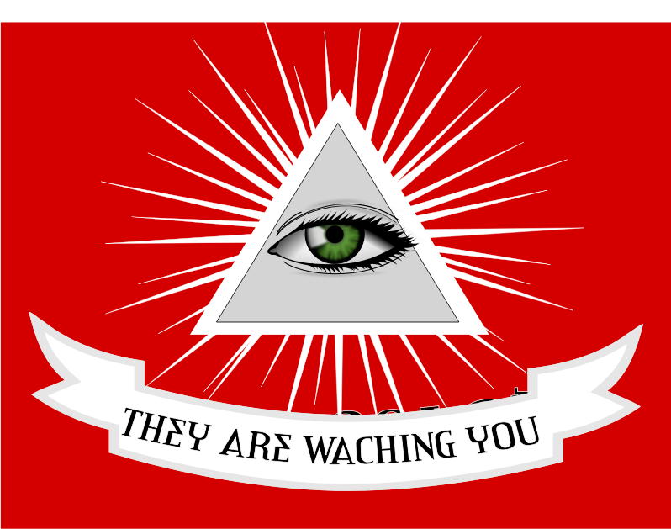
The Giver: Dystopia
Passions, memories, strong emotions, and pain and conflict are wiped away. While this seems happy and peaceful, the members of this society lack the basic freedoms and pleasures that our own society values which makes it dystopian fiction.
© Presto Plans

Slide 14
The Giver: Science Fiction
The Giver uses some characteristics of the Science Fiction genre. Firstly, it takes place in a futuristic setting. This setting is used by the author to examine social structure and governmental control. While this is set in a futuristic world, its imaginary elements are largely possible. Some futuristic aspects include not being able to see color, medication to stop the stirrings, erasing community members’ memories, and transferring memories through touch.
© Presto Plans

Slide 15
Fonts Not Appearing Correctly?
Install the following font to your computer and reopen this presentation.
http://www.fontspace.com/font-diner/cherry-cream-soda
© Presto Plans

Slide 16
Terms of Use
The original purchaser of this document is granted permission to copy for teaching purposes only. If you are NOT the original purchaser, please download the item from my store before making any copies. Redistributing, editing, selling, or posting this item or any part thereof on the Internet are strictly prohibited without first gaining permission from the author. Violations are subject to the penalties of the Digital Millennium Copyright Act. Please contact me at prestoplans@gmail.com if you wish to be granted special permission.
© Presto Plans

