Slide 1
Conflict

Slide 2
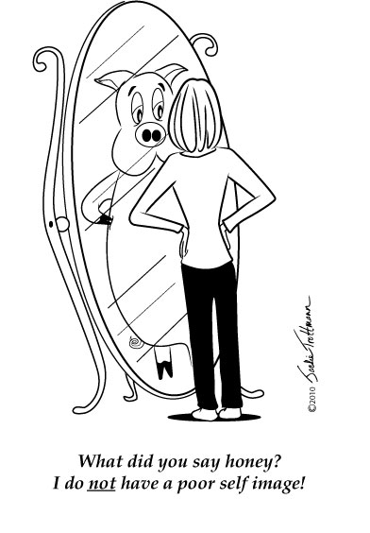
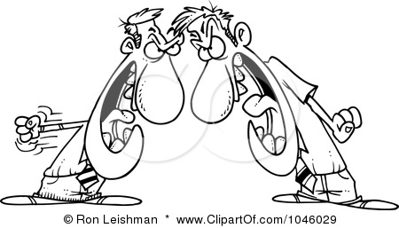
Silently, take one minute and think about what is going on in this picture.
Discuss your thoughts with a neighbor.
Look at the second picture and repeat this process. First, reflect silently for a minute then discuss your thoughts with a neighbor.
Notes:
Into: have students discuss the conflict occurring in each picture. Transition into the learning objective “These are two representations of conflict”

Slide 3
Learning Objective
Identify conflict in a text excerpt or short story and label it internal or external using the “SWBS” model then determine if it is character vs. character, self, nature, or society
Notes:
Ask for volunteers to read the learning objective aloud to the class.

Slide 4
Review
Conflict: A struggle between opposing characters or opposing forces.
Conflicts are the complications that move stories forward.
Characters try to solve the conflicts in the story.
Notes:
Before beginning the lesson review these terms with students. Have students read these review items out loud with a partner sitting next to them to help retention.

Slide 5
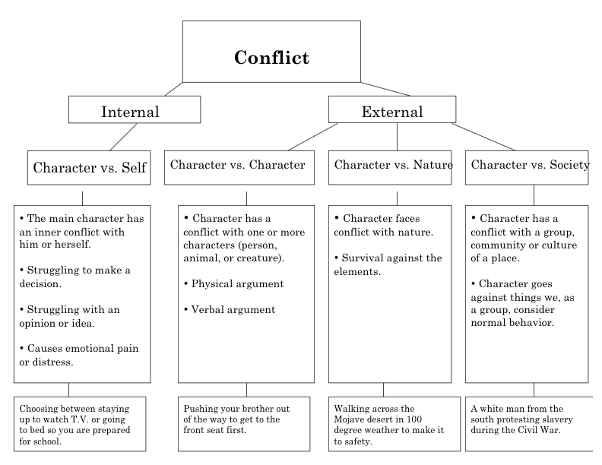
Big Idea
Notes:
Direct Instruction: Read through the graphic organizer with students. Break down the two main categories of conflict. Then what characterizes each category.

Slide 6
Model #1
Sarah has a history project due tomorrow. She has had two weeks to work on it but has not started. Sarah wants to go out with her friends tonight but is worried about getting a bad grade. She is contemplating if she should go out or stay home.
Internal Conflict
Character vs. Self
Notes:
Model: Think aloud process to determine what type of conflict this is.

Slide 7
STEPS
1. First, read the text.
2. (SOMEBODY) Identify the main character.
3. (WANTED) Determine what the character wants.
4. (BUT) Ask yourself, “Who or what is coming between the character and what they want?”
5. (SO) Finally, ask yourself, “Is this conflict between the character and himself or herself, or is it between the character and an outside force?” Depending on your answer label your conflict as internal or external.
6. If it is internal it is character vs. self. If it is external, look at the notes and example for each option. Choose character vs. character, nature or society.
Notes:
Model Expert Thinking. Tell students that to determine the conflict in the first example you asked yourself “somebody, wanted, but , so”
Have studetns read over the steps with a partner to help retention.

Slide 8
Model #2
STEP 1: Read Text
Jim’s dad is driving him and his friends to a big football game in town. Although they left in plenty of time, he seems to have lost his way. Jim thinks he saw the football field a couple of blocks back. When he tells his dad, he says, “Who’s driving—you or me?”
Notes:
Model #2: Model the “steps” using a second example.

Slide 9
Step 2: Somebody
Jim
Step 3: Wanted
…wanted to go to the football game
Step 4: But
…his dad got lost and wouldn’t take directions
Step 5: So
his struggle is EXTERNAL. Character vs. Character

Slide 10
Guided Practice
#1: Martha wants to go away for school. She is offered a partial ride to a boarding school in Japan and a full ride to a boarding school in Pennsylvania. She doesn't know which opportunity she should choose.
INTERNAL
Character vs. self
Notes:
Use the whiteboards to complete the guided practice. Have students complete the “somebody, wanted, but, so” graphic organizer to practice determining what type of conflict is being given.

Slide 11
Guided Practice
#2: On a visit to a New England boarding school, a group of Philadelphia Academy students get stuck in an ice storm and have to reschedule one of their visits to a class lecture.
EXTERNAL
Character vs. nature

Slide 12
Guided Practice
#3: For the past month, older middle school boys have bullied you on the school bus. They typically call you names, and sometimes, even poke at you. Finally one day, you get fed up and scream, “Don’t ever touch me again!”
EXTERNAL
Character vs. Character

Slide 13
Guided Practice
#4: Marissa’s school has a state level ice-hockey team—for boys. When Marissa and a group of girlfriends want to start a girls’ hockey program, She is told that, although it’s a nice idea, girl’s hockey is not something they are willing to endorse.
EXTERNAL
Character vs. society

Slide 14
Guided Practice
#5: Although Jessica’s friends say that shes very attractive, she thinks just the opposite. She often beats herself up about her weight and overall physical appearance.
INTERNAL
Character vs. self

Slide 15
Guided Practice
#6: Tom thinks someone from his fifth period class is extremely cute! He’s been trying to work up the nerve to ask her out, but he’s just too scared.
INTERNAL
Character vs. self

Slide 16
Review
What are the two main types of conflict?
Conflict is also known as what?
What are the 3 types of external conflict we talked about?
Which type of conflict deals with a character having an individual struggle that causes emotional pain?
Which type of conflict deals with a character having a struggle with another person, animal, or creature?
Which type of conflict pits the main character against the elements, such as a thunderstorm or tornado?
Which type of conflict deals with the character going against what a large group considers normal behavior?
Notes:
Big Idea Retention Questions: Have students answer the following questions aloud. I take volunteers and pay them using cub cash from my token economy system.

