Slide 1
Types of Conflict

Slide 2
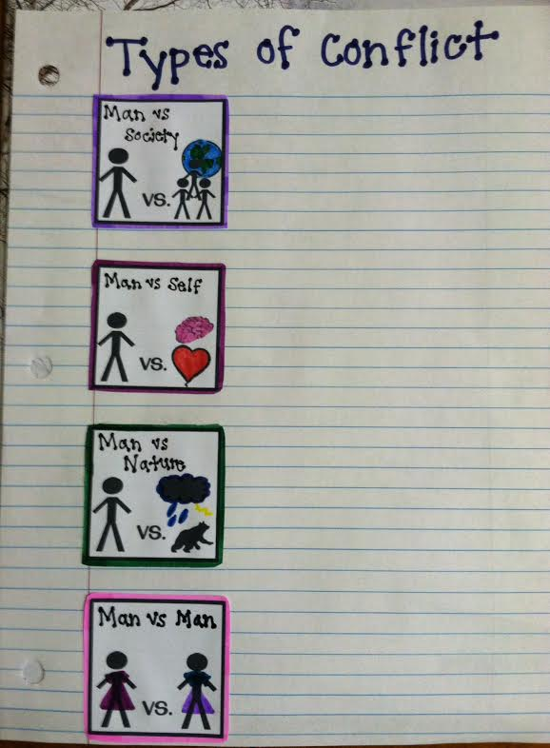
Step 1: Add “Conflict Notes” to your table of contents in your ISN (composition notebook!)
Step 2: Cut out and glue each of the pictures into your notebooks so it looks like this:
Glue in this order:
Man vs. Man
Man vs. Self
Man vs. Society
Man vs. Nature

Slide 3
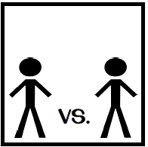
Man vs. Man
A struggle, mental or physical, between two characters
The other character may be the antagonist
Example: Pushing your sibling out of the way so you can get to the front seat first
External
Man vs. Man

Slide 4
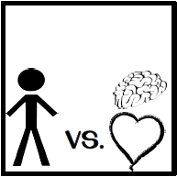
Man vs. Self
A struggle within a character’s own feelings, thoughts, or fears
Example: Choosing between staying up to watch TV or going to bed so you are well rested for school
Internal
Man vs. Self

Slide 5
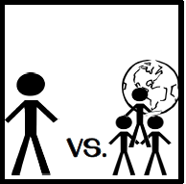
Man vs. Society
A struggle between a character and the laws or beliefs of a group
This can involve poverty, politics, social norms, expectations, or values
Example: a student stands up for what he/she believes is right, even though almost everyone disagrees with him/her
External
Man vs. Society

Slide 6
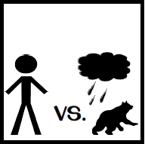
Man vs. Nature
A struggle between a character and mother nature
Mother nature can be considered weather, animals, insects, sickness, epidemics
Example: A family hiding in the basement during a tornado
External
Man vs. Nature

Slide 7
Review
Conflict is a struggle between opposing characters or opposing forces.
Conflicts are the complications that move the story forward.
Remember the toy story videos we watched showing internal and external conflict?
Internal conflict takes place inside a characters mind or heart and sometimes involves a decision
External conflict takes place between a character and someone or something else

