Slide 1
Theme-ISN

Slide 3
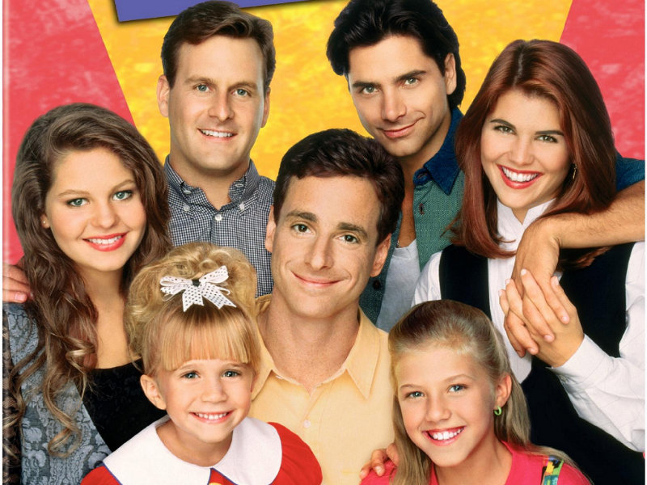

Slide 5
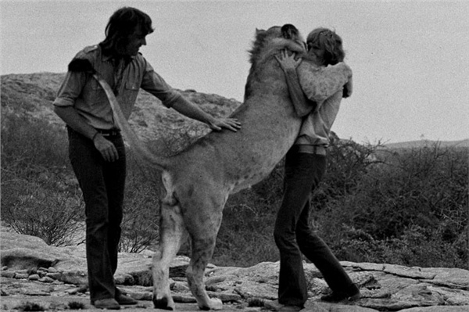

Slide 7
Notes for Theme Tree:
Theme – the central idea or truth a story reveals about life
it is a moral, life lesson, message, or meaning
it is a debatable opinion.
it is implied, not stated.
ANY theme can be considered valid IF you can support it with
text evidence!

