Slide 1
“The Prince and the Pauper”
Vocabulary

Slide 2
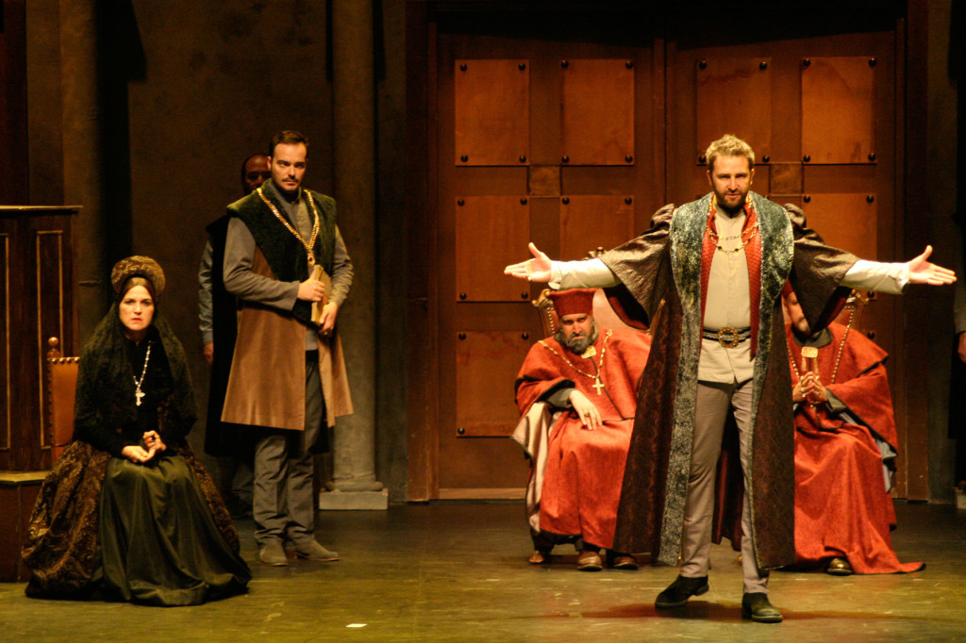
1. ad lib - verb
to speak or perform in public without previously preparing one’s words

Slide 3
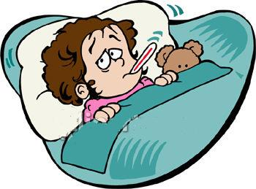
2. affliction – noun
pain or suffering

Slide 4
3. anteroom - noun
an outer room used as a waiting room

Slide 5
4. bedlam - adjective
a scene of uproar and confusion

Slide 6
5. courier - noun
a person who carries a message

Slide 7
6. deceive – verb
to cause someone to believe something that is not true

Slide 8
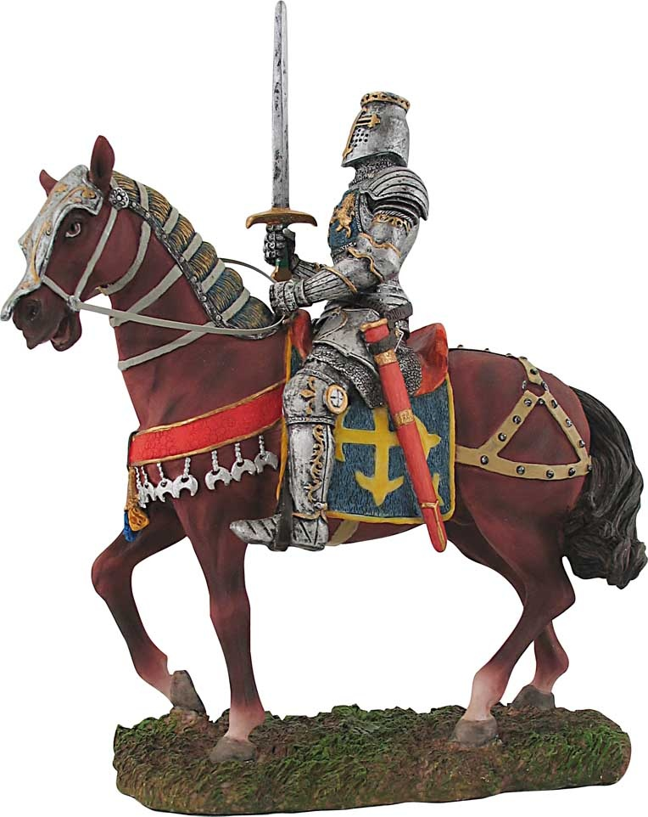
7. gallant - adjective
brave; heroic

Slide 9
8. imposter - noun
a person who pretends to be someone else in order to deceive

Slide 10
9. pauper -noun
a very poor person

Slide 11
10. successor - noun
a person who inherits some title or office

