Slide 1
The Outsiders Vocabulary List 1 Chapters 1-2

Slide 2
1. Abiding: (adjective) Obeying or enduring, or long lasting
Example: By raising my hand, I was abiding by the rule, “ Don’t talk out in class.”

Slide 3
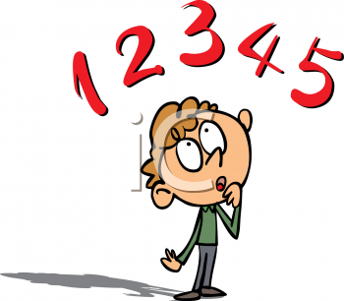
2. Digest : (Verb) to think over or absorb (like information)
Example: I digested the information for Algebra class by studying all night.

Slide 4
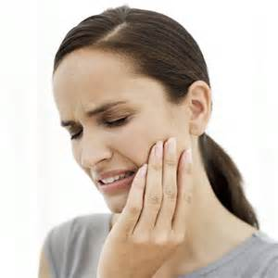
3. Gingerly: (adjective) cautiously, carefully
Example: Even when I gingerly touch my cheek, my whole face hurts from my toothache.

Slide 5
4. Incredulous: (adjective) not ready to believe or doubtful
Example: I felt incredulous when I heard that we would dismiss at 10:00 on Friday, so I checked with Mr. Abel to make certain it was true.

Slide 6
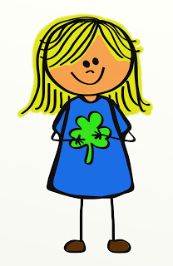
5. Nonchalantly: (adverb) in a casual unenthusiastic manner
Example: After he fell in front of the cute girl, he walked away nonchalantly so she wouldn’t know he was embarrassed.

Slide 7
6. Rivalry: (noun) when people or groups compete against each other
Example: The rivalry between Luigi and Mario began when they were competing to see who was the best plumber.

Slide 8
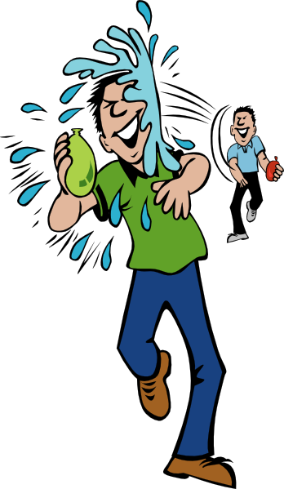
7. Roguishly: (adverb) acting in a mischievous or irresponsibly playful way
Example: He roguishly hit his friend with a water balloon after he turned his back.

Slide 9
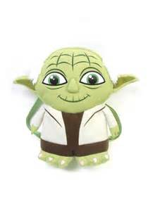
8. Sagely: (Adverb) wisely
Example: Yoda sagely gave the advice, “Try not. Do or do not, there is no try.”

Slide 10
9. Sarcasm: (noun) the use of words that mean the opposite of what you really want to say, especially in order to insult someone, to show irritation, or to be funny.
Example: “I love school more than sleeping,” said the student using sarcasm.

Slide 11
10. Unfathomable: (adjective) not capable of being understood or grasped.
Example: The speed of the data and information transfer on the internet is unfathomable for many people.

