Slide 1
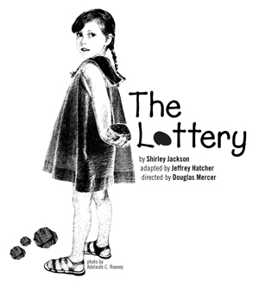
“The Lottery” Vocabulary List

Slide 2
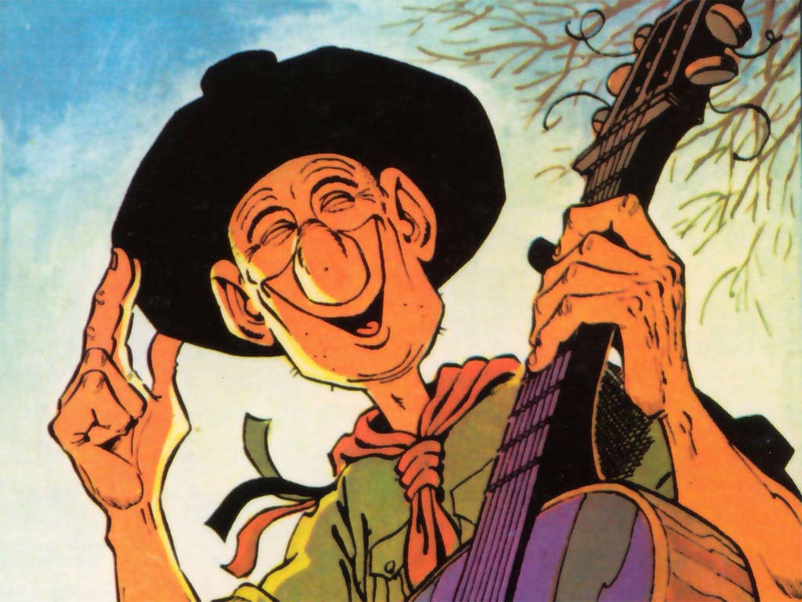
Jovial
Adjective
Characterized by hearty or good natured humor; jolly
She was in a jovial mood, smiling and happily greeting everyone she saw on the street.

Slide 3
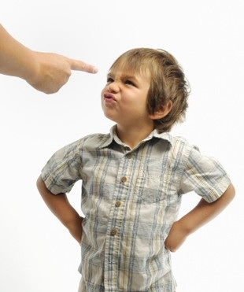
Defiantly
Adverb
Openly or boldly resisting
When the mother told the little boy not to throw his food on the floor, he looked at her defiantly, and then threw Cheerios everywhere.

Slide 4
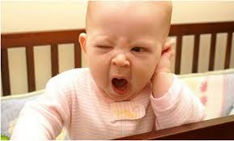
Disengaged
Adjective
Released or loosened from something; emotionally detached
The students were disengaged in the lesson. Some were sleeping, while others were throwing paper airplanes across the room.

Slide 5
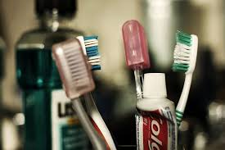
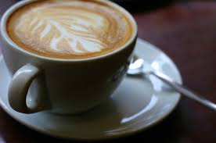
Ritual
Noun
A routine followed faithfully
I hope that brushing your teeth is a daily ritual for you because I wouldn’t want you to have multiple cavities.

Slide 6
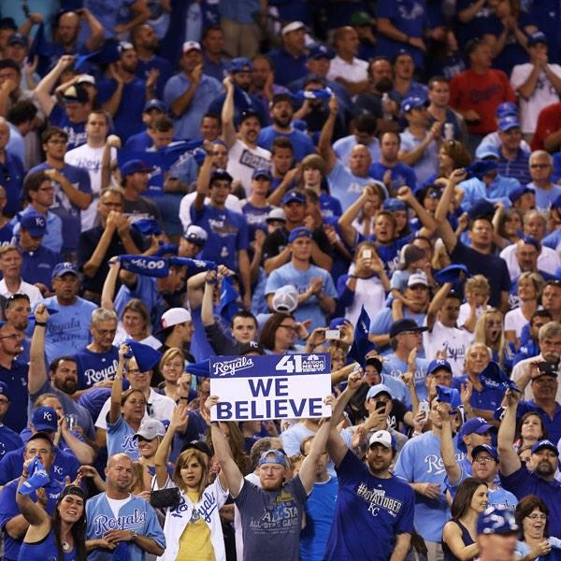
Boisterous
Adjective
Noisy; high spirited
The boys gathered together quietly for a while before they broke into boisterous play.

Slide 7
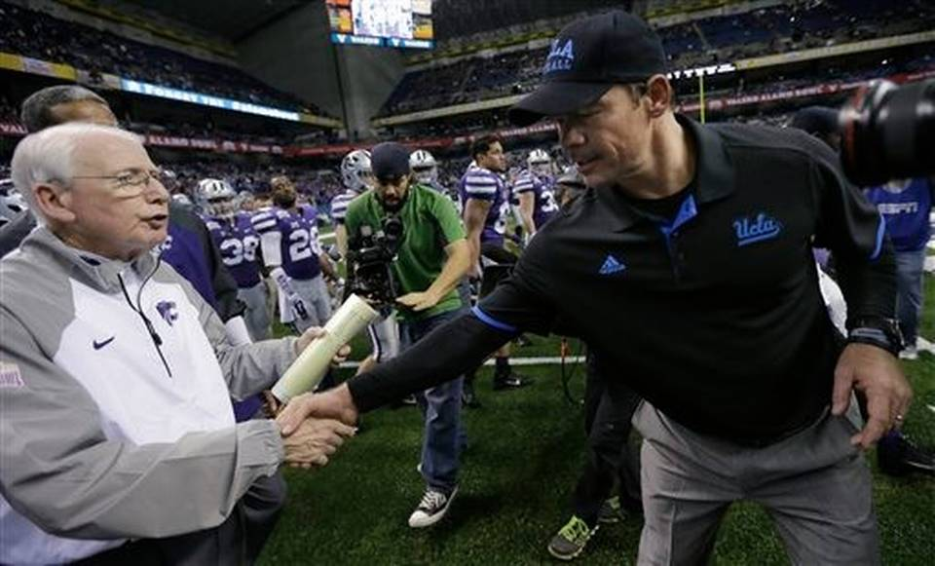
Perfunctory
Adjective
Performed merely as a matter or routine
The coaches gave each other a perfunctory handshake after the game.

Slide 8
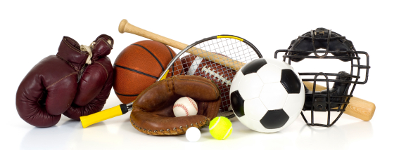
Paraphernalia
Noun
Equipment used for a particular purpose or activity
Our neighbors have a ton of camping paraphernalia, so we borrowed a tent from them for our yearly camping trip.

Slide 9
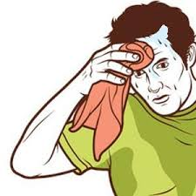
Profusely
Adjective
Given freely; lavishly
The flowers were blooming profusely and the grass was richly green.

Slide 10
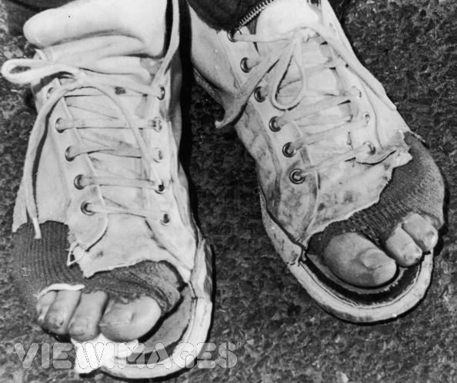
Shabbier
Adjective
Faded and dingy from wear or exposure
My brother’s cleats grew shabbier each year, but he would not replace them because he said they were his “lucky” cleats that helped him win every game.

Slide 11
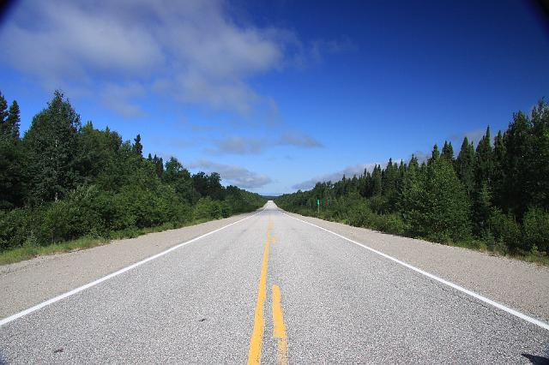
Interminably
Adverb
Never ending; having no limits; continually
The war went on interminably, without any real progress on either side.

