Slide 1
The Giver Vocabulary from Chapters 1-4

Slide 2
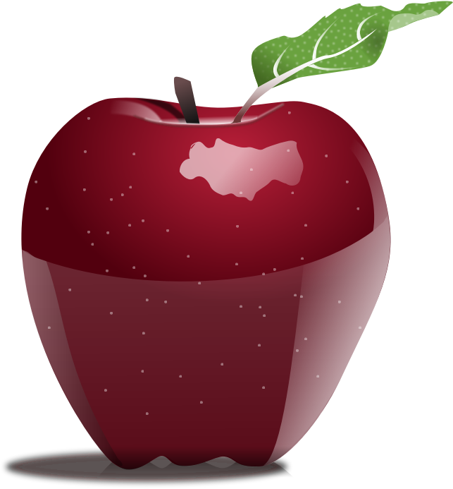
Chapter 1 - 2
Synonyms/Definitions of Words
1. Grim – forbidding; threatening; serious; harsh
2. Jeering – teasing; mocking; ridicule
3. Wheedle – coax; persuade; convince
4. Vital – necessary; important; essential
5. Prominent – important; leading; in the forefront
6. Adherence – follow; comply; conform; submit
7. Aptitude – strength; natural ability; talent
© Presto Plans

Slide 3
Chapter 5 - 6
1. “His mother told of a dream fragment, a disquieting scene where she had been chastised for a rule infraction” (34).
2. “The bicycle…would be a powerful emblem of moving gradually out into the community” (41)
3. “’I want to get a good seat in the auditorium’ she prodded Lily to the front door and Jonas followed” (41).
© Presto Plans

