Slide 1
"Stray"
vocabulary

Slide 2
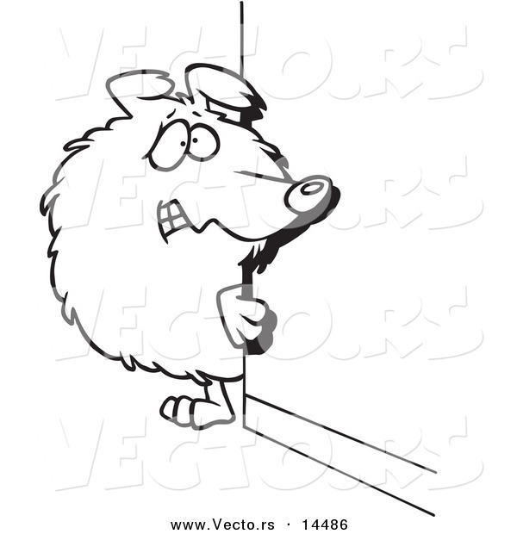
1. timidly
“The puppy stopped in the road, wagging its tail timidly...”
Denotation: adverb – shyly; in a frightened way

Slide 3
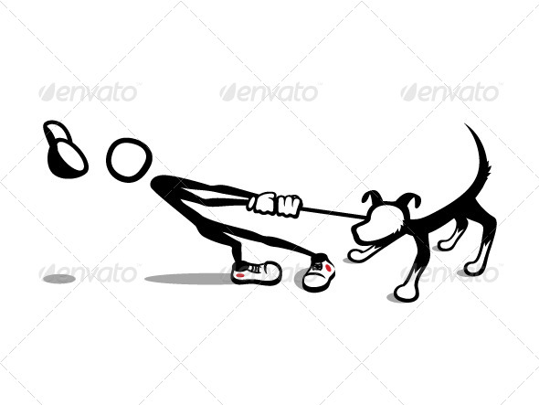
2. grudgingly
“He agreed to let the dog sleep in the basement while Mrs. Lacey grudgingly let Doris feed it table scraps.
Denotation: adverb – not happily; in a resentful or reluctant way

Slide 4
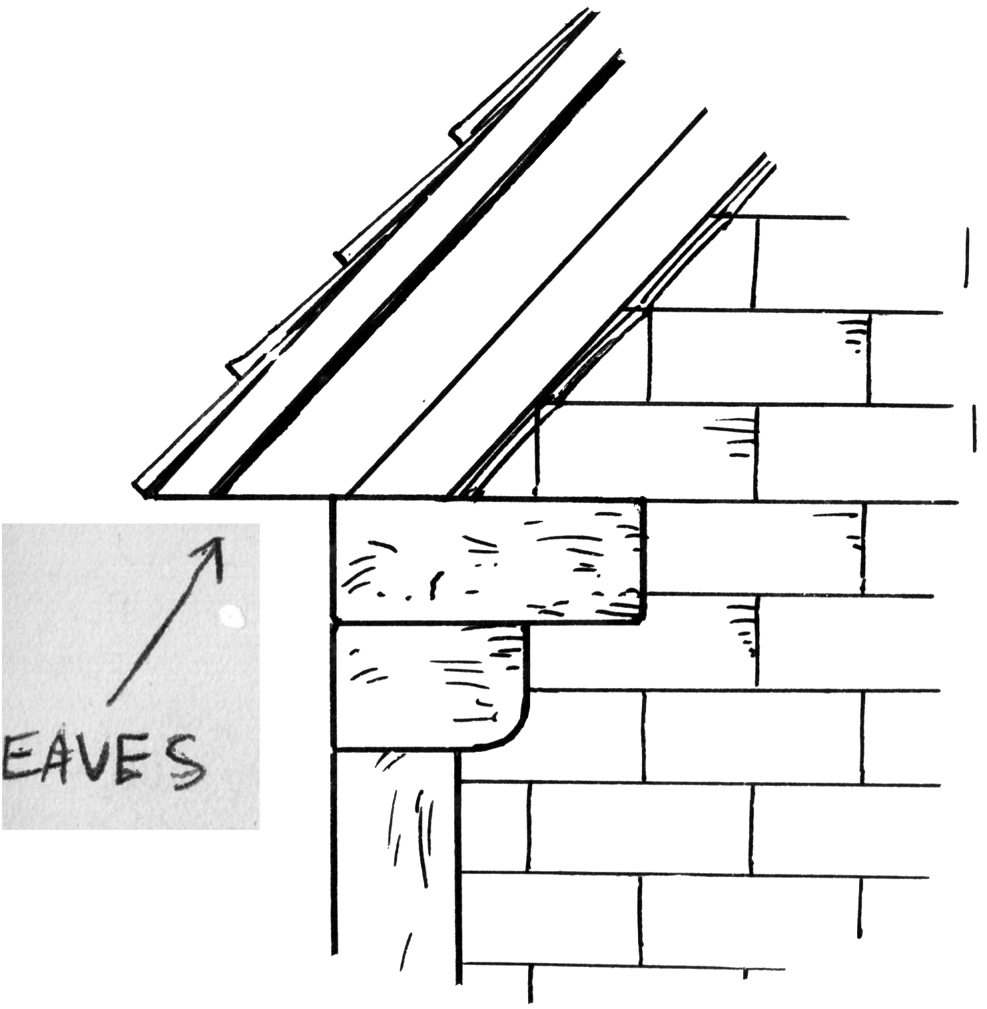
3. eaves
“Icicles hung three feet or more from the eaves of houses…”
Denotation: noun – the projecting overhang at the lower edge of a roof

Slide 5
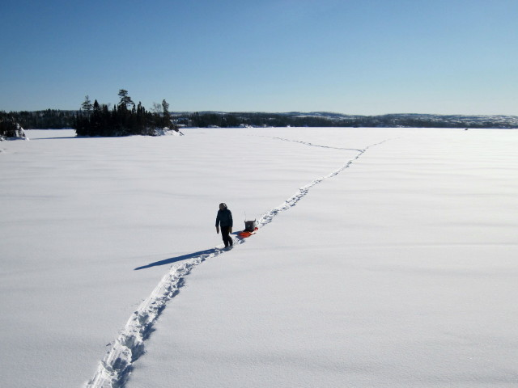
4. trudge
“Doris trudged through the yard, went up the shoveled drive, and met the dog.”
Denotation: verb – plodded; walked slowly with effort

Slide 6
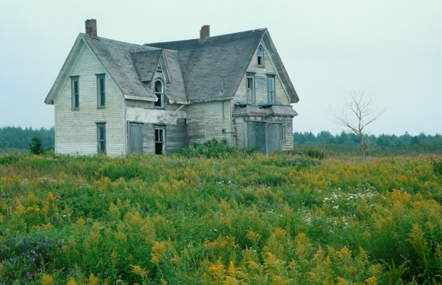
5. abandon
“The puppy had been abandoned…its ears tucked, its tail between its legs, shivering.”
Denotation: verb – tossed aside; left behind

Slide 7
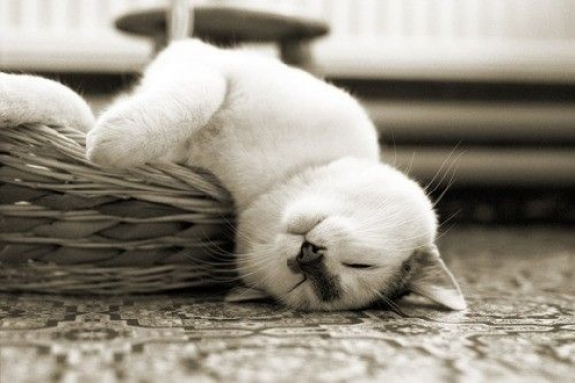
6. exhausted
“Lying there, like stone, still exhausted, she wondered if she would ever in her life have anything.”
Denotation: adjective – very tired and worn out

Slide 8
7. distress
“Her face was wet and red, her eyes full of distress.”
Denotation: noun – difficulty, pain or sadness

Slide 9
8. tremble
“The puppy stopped in the road, wagging its tail timidly, trembling with shyness and cold.”
Denotation: verb – to shake involuntarily as from excitement or fear

