Slide 1
Story Elements

Slide 2
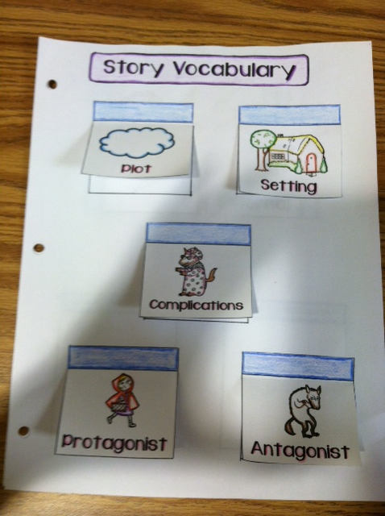
Story Elements Foldable
Your foldable should be cut and pasted just like the example in the picture.
1) First, cut out each individual square. For each square, leave the thin rectangle at the top attached to the larger rectangle.
2) Once you have cut out each square, fold the tab at the top, and then glue the back of the tab only, so that each tab swings up and open. Make sure you spread them out on the notebook page so that all the pieces fit.
Notes:
Plot-the chain of events that make up a story
Setting-the time and place of a story
Complications-problems that arise as characters
struggle to reach their goals
Protagonist-the main character in a story
Antagonist-the character or force in a conflict
with the protagonist

Slide 3
Little Red Riding Hood

Slide 4
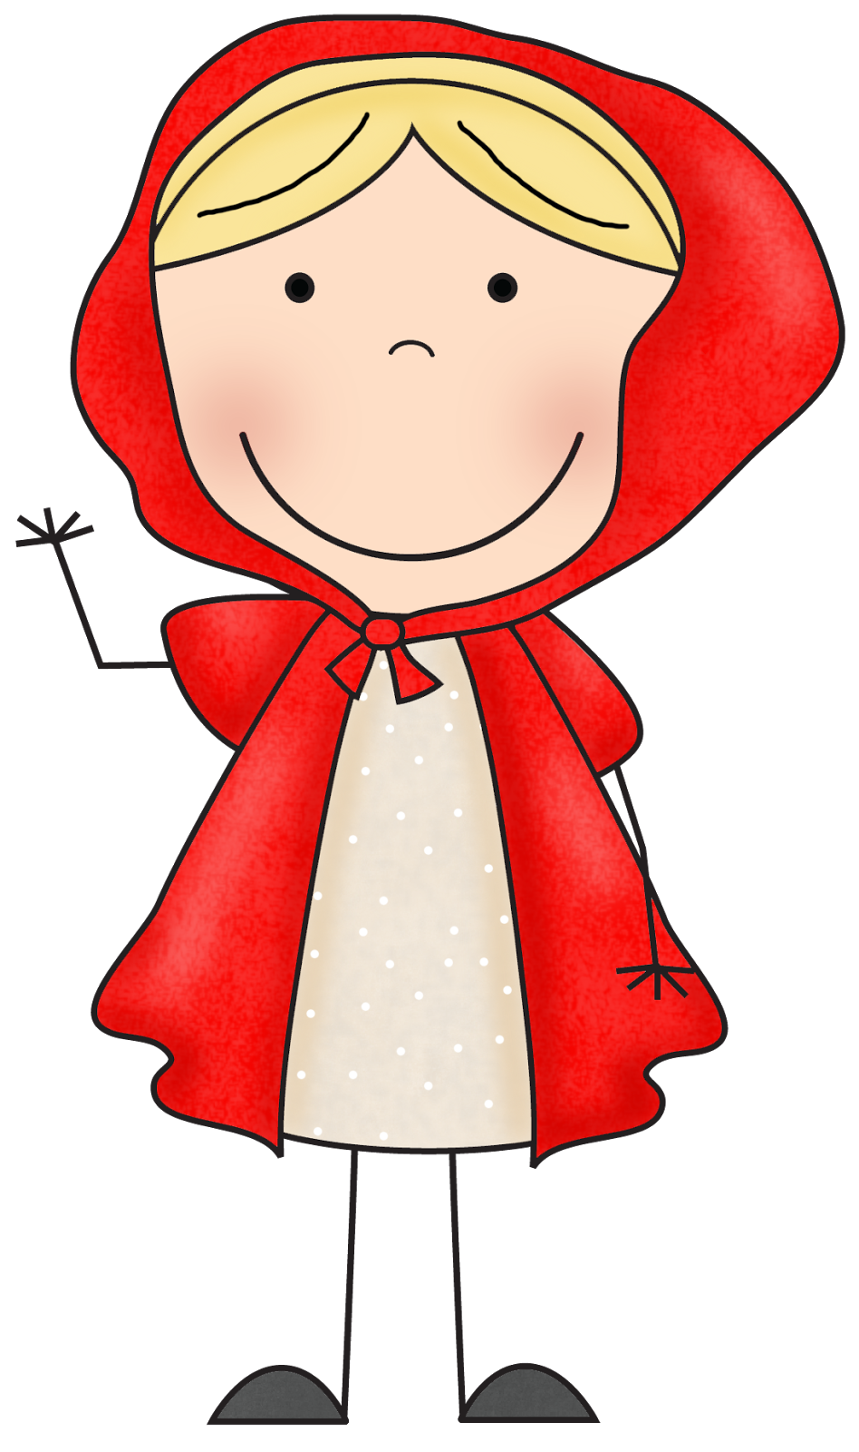
Plot Elements in Little Red Riding HOOD
Plot – While visiting her sick Granny, Little Red
Riding Hood finds the big, Bad Wolf dressed as
Granny and in her bed to trick Little Red so that
he can eat her!
Setting – In the woods, at Granny’s house, a long
time ago
Complications – Big Bad Wolf eats Granny and
pretends to be her
Protagonist – Little Red Riding Hood
Antagonist – The Big Bad Wolf

Slide 5
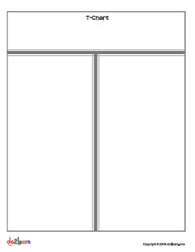
Story Elements In The Lightning THEIF
Create a T-chart on page 9 in your ISN.
Title that page “Story Elements in TLT”
Add that to your table of contents
In the first column, label it “story elements”
Under the first column number 1-5 and write out the story elements that we just took notes on.
In the second column label it “Story elements in TLT”
Fill out the second column by explaining the story elements in The Lightening Thief

