Slide 1
Back to School
2015-2016

Slide 2
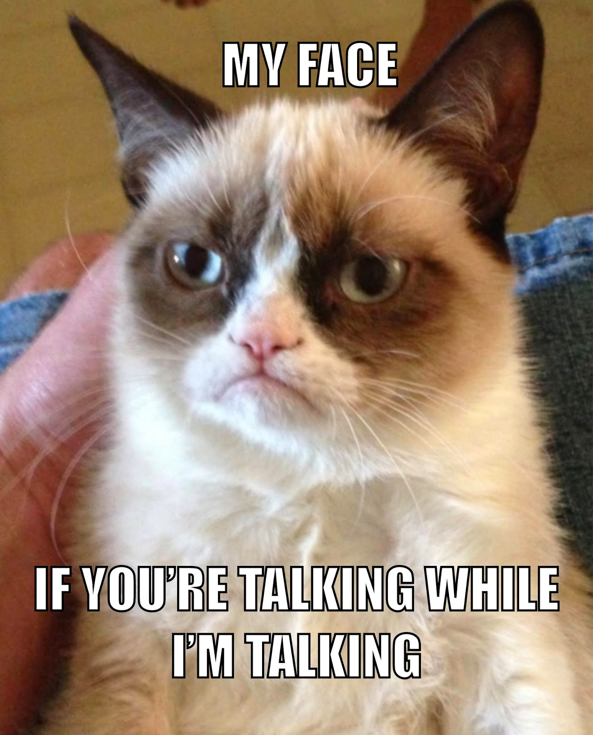
Class Rules
Students are expected to:
Respect themselves and others at all times.
Be on time.
Bring all materials to class.
Do not talk while the teacher is talking.
Do what the teacher asks of you.
Strive for excellence.
All school policies and rules explained in the student handbook will be followed and enforced.
*If these rules are broken, one of the following penalties will be issued:
1st offense: Conference with student
2nd offense: Parent phone calls
3rd offense: Office referral
*A truly severe infraction may result in immediate referral.

Slide 3
Materials Needed for Class
A three-ring binder and notebook paper (This binder can be shared with other classes.)
Pens, pencils, highlighter
Glue stick
Composition Notebook-This will be provided for you.
You must have all of these material with you in class every day.

Slide 4
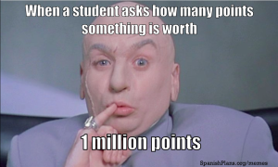
Grading Policies
Grading Scale Grading Policy
A (93 – 100) -Tests/Exams, Projects, and Essays will
B (85 – 92) equal 40% of the final grade.
C (77 – 84) -Class Work, and Homework
D (70 – 76) will equal 25% of the final grade.
F (69 and below) -Quizzes will equal 35% of the final grade.
Homework Policy
Expect homework 2-3 times per week. On the assigned date, homework is due at beginning of the class period. Students will be notified of tests, essays, and projects well in advance of their due dates.

Slide 5
Late Work and Make-up Work Policy
A ZERO will be given for any late homework. If a project is late, 10 points will be taken off per day late. Students that do not a have a major assignment on the day it is due will have to fill out a Missing Work Log. An oops pass may only be used for small homework assignments, not for projects or tests. Please remember: the oops pass assignment is STILL DUE the following day for full credit.
If a student is absent, he / she should arrange to make up any missed class work, homework, quizzes, and tests.
*DO NOT ASK ME ABOUT MAKE UP WORK DURING CLASS. You may do one of the following things:
Check the make-up work folder before class begins.
Set up a time to meet with me, either before or after school, to go over what you missed.
Check my website.

Slide 6
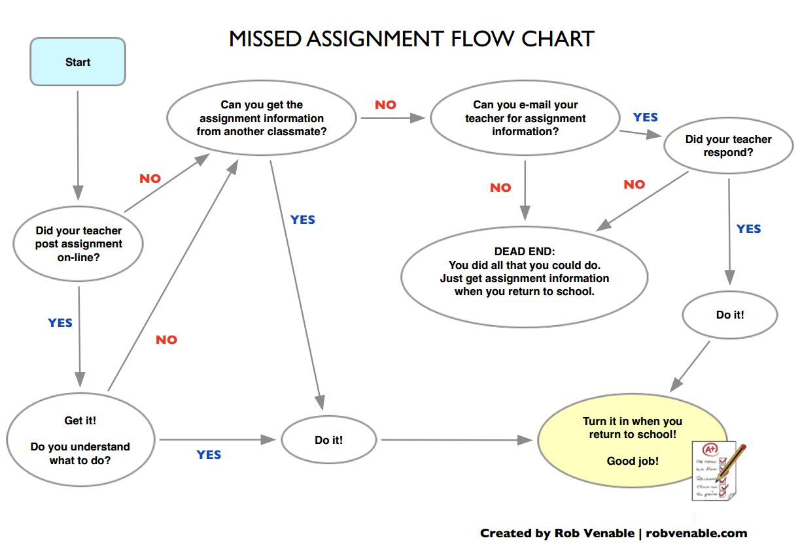
Missing Work Flo-Chart

Slide 7
Assignment Posting
I will post daily homework assignments and any special instructions on my website: http://mrsgarrisonenglish.weebly.com/
Please use this tool as a SUPPLEMENT to the student planner to keep up with your child’s assignments. Your child is responsible for writing down and keeping up with assignments. Please do not rely on the website alone for assignments because occasionally, I will be unable to post assignments on the website. The student planner should be the first means of keeping track of assignments.

Slide 8
7th Grade ELA Schedule
 | 1st quarter | 2nd quarter | 3rd quarter | 4th quarter
Literature | Summer Reading: Hatchet Survival Unit Unit Test Short Stories “Rogue Wave” “The Lottery” Literary Terms Figurative Language review Reading RIOT | Drama Elements of drama Monsters are Due on Maple Street Charles Dickens background information A Christmas Carol play Reading RIOT | Novel Study: The Outsiders by S.E. Hinton Literary Elements Research Nonfiction Elements of Nonfiction Informational text features Reading RIOT | Novel Study The Giver Literary Elements Poetry Standardized state test review Reading RIOT
Writing | Writing 101 The writing process Structure and organization Business Letter Journal Writing Weekly writing assignments Plagiarism | Ongoing writing instruction Narrative Writing Journal responses Weekly writing assignments | Ongoing writing Literary Analysis Research Argumentative writing Plagiarism review Journal responses Weekly writing assignments | Ongoing writing instruction Literary Analysis Poetry portfolio Journal responses Weekly writing assignments
Vocabulary | Literature based vocabulary Context clues | Literature based vocabulary Context clues | Literature based vocabulary Roots and stems Context clues | Literature based vocabulary Roots and stems Context clues
Grammar | Review from 6th grade Parts of Speech Sentence structure Mechanics | Sentence Structure Compound Complex Compound-complex | Ongoing grammar instruction as needed | Grammar review for standardized state test

