Slide 1
Back to School
2015-2016

Slide 2
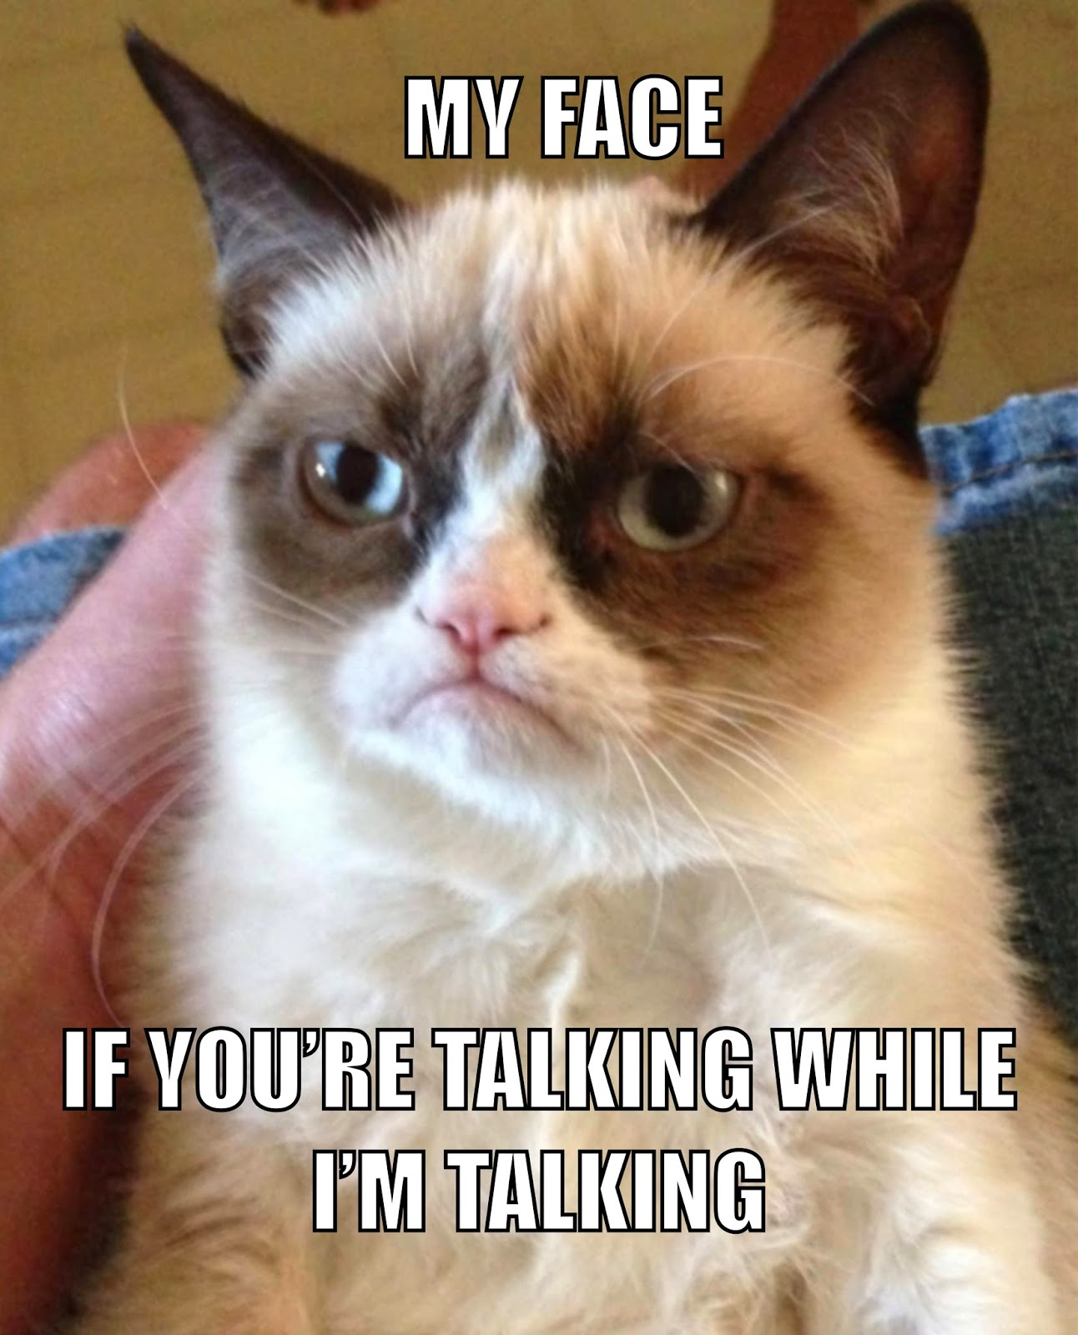
Class Rules
Students are expected to:
Respect themselves and others at all times.
Be on time.
Bring all materials to class.
Do not talk while the teacher is talking.
Do what the teacher asks of you.
Strive for excellence.
All school policies and rules explained in the student handbook will be followed and enforced.
*If these rules are broken, one of the following penalties will be issued:
1st offense: Conference with student
2nd offense: Parent phone calls
3rd offense: Office referral
*A truly severe infraction may result in immediate referral.

Slide 3
Materials Needed for Class
A three-ring binder and notebook paper (This binder can be shared with other classes.)
Pens, pencils, highlighter
Glue stick
Composition Notebook-This will be provided for you.
You must have all of these material with you in class every day.

Slide 4
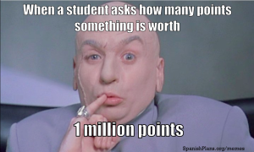
Grading Policies
Grading Scale Grading Policy
A (93 – 100) -Tests/Exams, Projects, and Essays will
B (85 – 92) equal 40% of the final grade.
C (77 – 84) -Class Work, and Homework
D (70 – 76) will equal 25% of the final grade.
F (69 and below) -Quizzes will equal 35% of the final grade.
Homework Policy
Expect homework 2-3 times per week. On the assigned date, homework is due at beginning of the class period. Students will be notified of tests, essays, and projects well in advance of their due dates.

Slide 5
Late Work and Make-up Work Policy
A ZERO will be given for any late homework. If a project is late, 10 points will be taken off per day late. Students that do not a have a major assignment on the day it is due will have to fill out a Missing Work Log. An oops pass may only be used for small homework assignments, not for projects or tests. Please remember: the oops pass assignment is STILL DUE the following day for full credit.
If a student is absent, he / she should arrange to make up any missed class work, homework, quizzes, and tests.
*DO NOT ASK ME ABOUT MAKE UP WORK DURING CLASS. You may do one of the following things:
Check the make-up work folder before class begins.
Set up a time to meet with me, either before or after school, to go over what you missed.
Check my website.

Slide 6
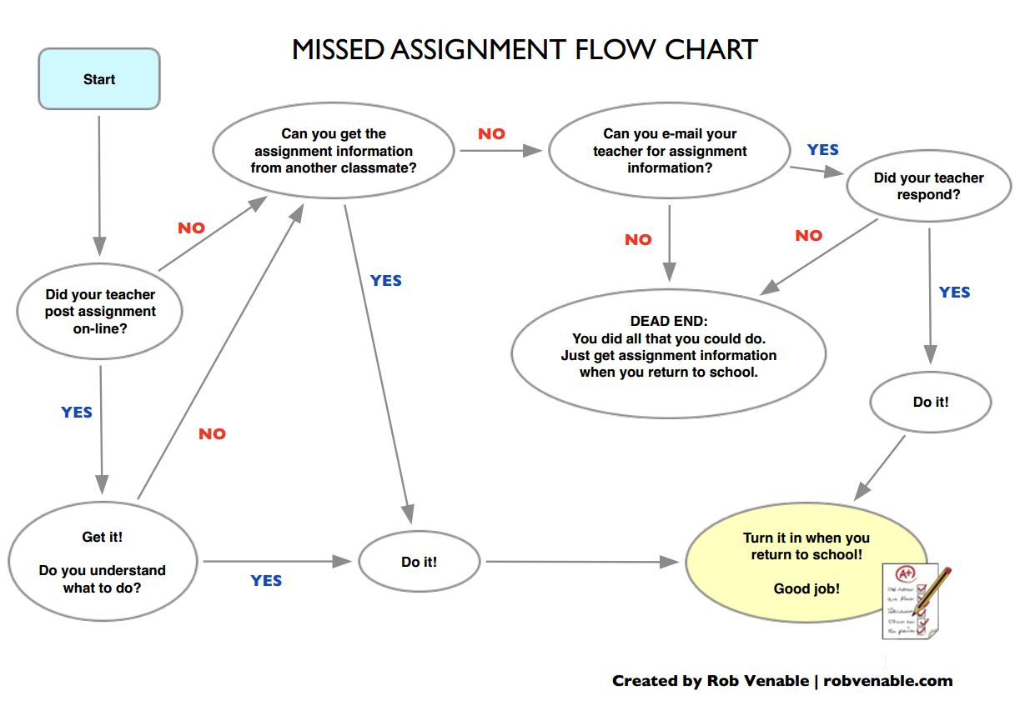
Missing Work Flo-Chart

Slide 7
Assignment Posting
I will post daily homework assignments and any special instructions on my website: http://mrsgarrisonenglish.weebly.com/
Please use this tool as a SUPPLEMENT to the student planner to keep up with your child’s assignments. Your child is responsible for writing down and keeping up with assignments. Please do not rely on the website alone for assignments because occasionally, I will be unable to post assignments on the website. The student planner should be the first means of keeping track of assignments.

Slide 8
6th Grade ELA Schedule
 | 1st quarter | 2nd quarter | 3rd quarter | 4th quarter
Literature | literary elements short stories summer reading novel study – Percy Jackson and the Olympians - The Lightning Thief “The Legacy of Dicey Langston” setting conflict Reading Riot | literary elements figurative language characterization, inferences, drawing conclusions novel study - Freak the Mighty by Rodman Philbrick literature genres point of view Reading Riot | informational text features nonfiction author’s purpose summarizing and paraphrasing drama elements The Prince and the Pauper Reading Riot | poetry element of poetry novel study – The Egypt Game by Zilpha Keatley Snyder standardized test review Reading Riot
Grammar | Parts of Speech review mechanics (capitalization, punctuation, apostrophes, common misspellings) sentence structure | sentence structure compound, complex sentences clauses focus on pronouns mechanics | sentence structure compound, complex sentences prepositions subject-verb agreement mechanics | -ongoing grammar instruction as needed
Writing | writing effective sentences elements of strong paragraph writing journal responses weekly writing assignments plagiarism | ongoing writing instruction journal responses weekly written assignments literature analysis portfolio | ongoing writing instruction journal responses weekly written assignments research writing propaganda | journal responses informational and argumentative writing
Vocabulary | vocabulary from novel study context clues | vocabulary from novel study context clues | vocabulary context clues roots and stems | vocabulary from literature study roots and stems

