Slide 1
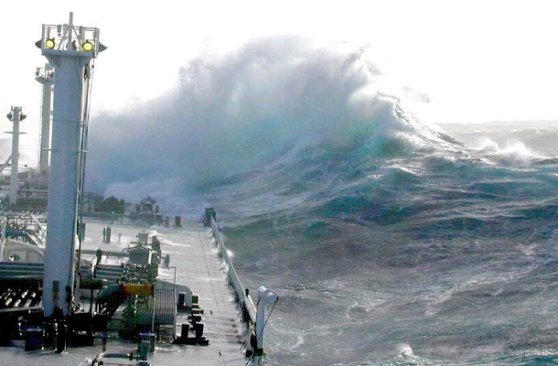
“Rogue Wave”
Theodore Taylor

Slide 2
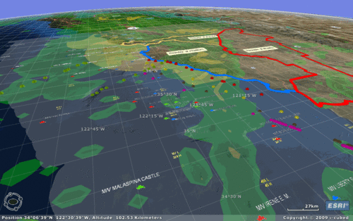
1. hydrography - noun
the science of the measurement, description and mapping of the surface waters of the earth with special reference to navigation

Slide 3
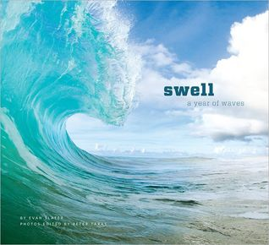
swell – noun
a slow, regular movement of the sea in rolling waves that do not break

Slide 4
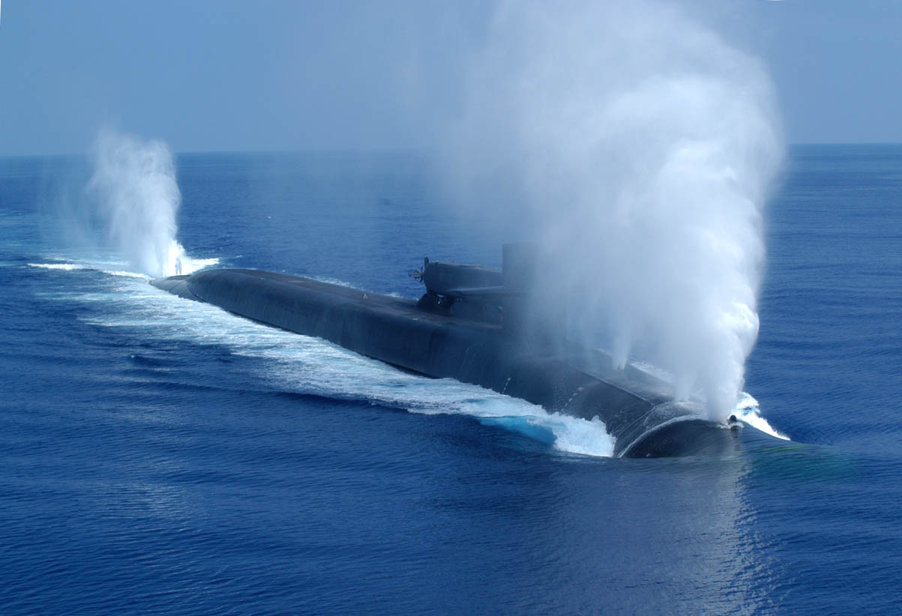
3. submerge - verb
fill or cover completely, usually with water

Slide 5
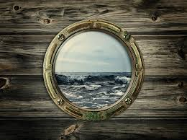
4. porthole - noun
a window in a ship or airplane

Slide 6
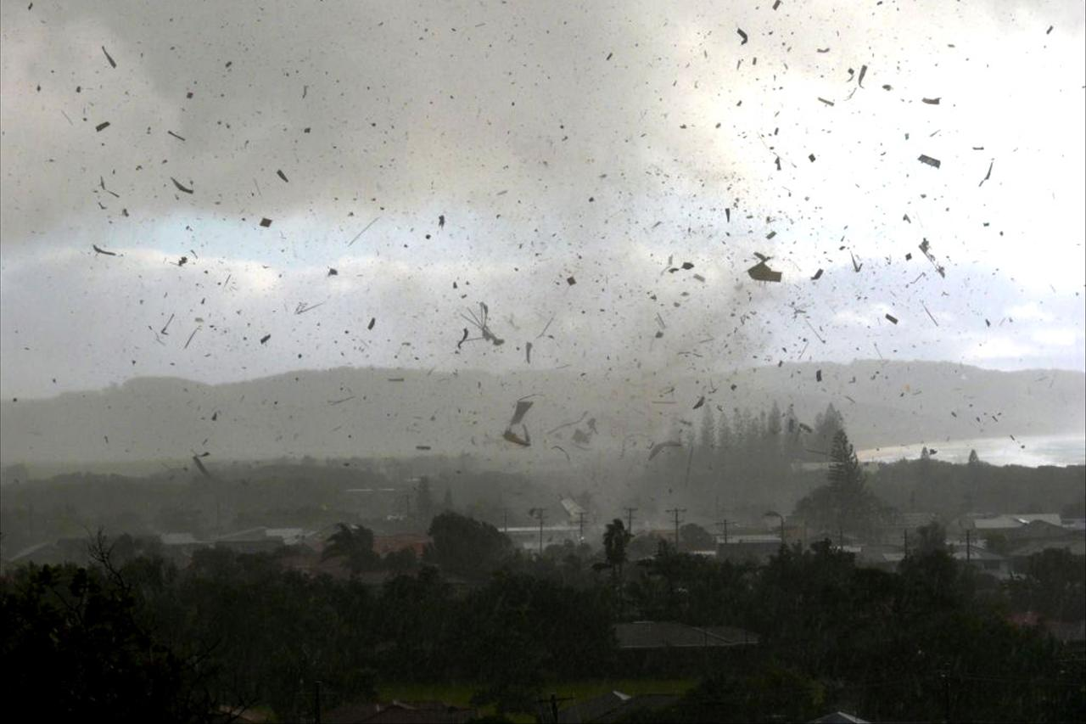
5. debris - noun
the remains of something that has been destroyed

Slide 7
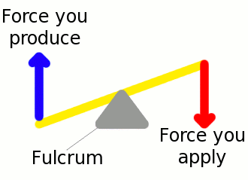
6. fulcrum - noun
the pivot about which a lever turns

Slide 8
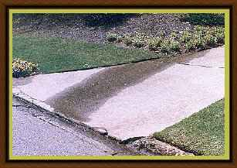
7. seep - verb
to pass gradually or leak through small openings

Slide 9
8. alcove - noun
a small recess opening off a larger room

Slide 10
9. mantra - noun
a commonly repeated word or phrase

Slide 11
10. survey - verb
look over carefully or inspect

