Slide 1
PRONOUNS

Slide 2
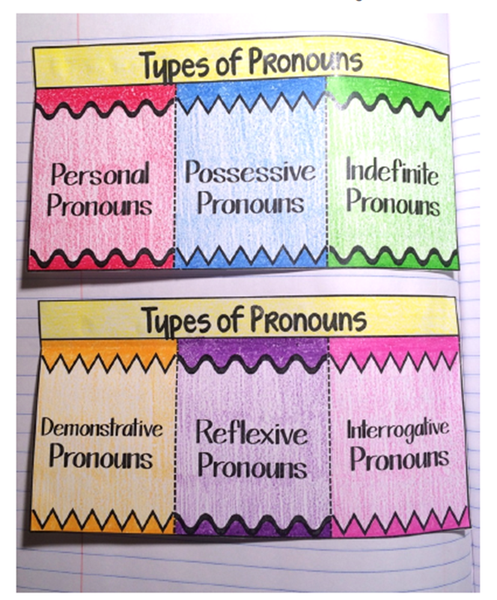
PRONOUNS
SUBJECT
OBJECT

Slide 3
PERSONAL PRONOUNS Subject pronouns
CLUES: subject of the sentence / doing the action / beginning of the sentence
Examples: I, you, he, she, it, we, they

Slide 4
PERSONAL PRONOUNS Object pronouns
CLUES: receives the action / end of the sentence
Examples: me, you, him, her, it, us, them

Slide 5
PERSONAL PRONOUNS
Laura and (I, me) are in the same French class.
Bill went to the movies with John and (me, I).
Sam and Joe are trying to find (his, their) homeroom.
(Him, he) and (me, I) are going to the skate park.
Can you help Bob and (me, I) fix this?

Slide 6
POSSESSIVE PRONOUNS
CLUE: Pronouns that show ownership
Examples: my, your, his, her, its, our, their, yours, ours, theirs

Slide 7
POSSESSIVE PRONOUNS
Bill loaned (his, their) bike to Phillip.
In the evening, the chickens return to (its, their) roost.
The children performed a play for (his, her, their) grandparents.
The hamster slept in (its, their) empty food dish.
Both Shelly and Sue promised to bring (her, their) camera.

Slide 8
INDEFINITE PRONOUNS
CLUE: does not refer to any specific person or amount
Examples: anyone, anything, something, someone, several, everybody, no one, some

Slide 9
INDEFINITE PRONOUNS
“A classic is something that everybody wants to have read and nobody wants to read.” (Mark Twain, 1835-1910)
2. “Everything is funny as long as it is happening to somebody else.” (Will Rogers, 1879-1935)
3. “Everybody likes a kidder, but nobody lends him money.” (Arthur Miller, 1915-2005)
4. “I don't know anything about music. In my line, you don't have to.” (Elvis Presley, 1935-1977)

Slide 10
REFLEXIVE PRONOUNS
CLUE: refers (reflects) back to the subject
Examples: myself, yourself, ourselves, himself, herself, itself, themselves

Slide 11
REFLEXIVE PRONOUNS
You need to control _____________________ .
They could have kept ________________ out of trouble if they had listened to their mother.
Some people like to work with partners, but I prefer to work by _________________ .

Slide 12
INTERROGATIVE PRONOUNS
CLUE: pronouns that ask questions
Examples: who, whom, whose, which, what

Slide 13
INTERROGATIVE PRONOUNS
_____________ of the states has the largest population?
___________ is her occupation?
_________ is the actor with the award winning movie?
That is beautiful. _____________ is it?
With _____________ did you leave your phone number?

