Slide 1
Predicate Nominatives
Predicate Adjectives
Subject Complements

Slide 3
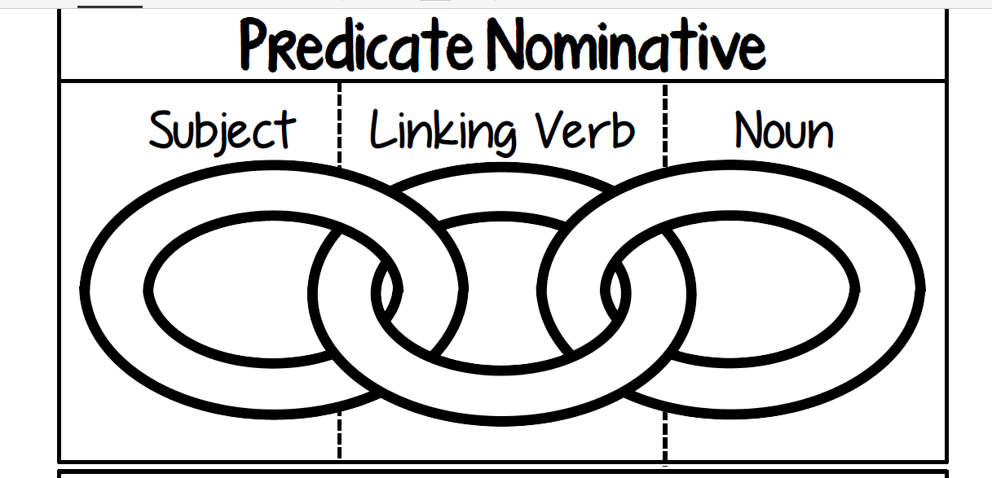
Sam
is
a doctor.

Slide 4
Predicate Nominative
A noun or pronoun that follows the linking verb and identifies or explains the subject

Slide 5
subject
linking verb
predicate noun
Mr. Richards is the mayor of Simpsonville.
Mr. Richards is WHAT?
subject
linking verb
predicate noun
I am a teacher at LCMS.
I am WHAT?

Slide 6
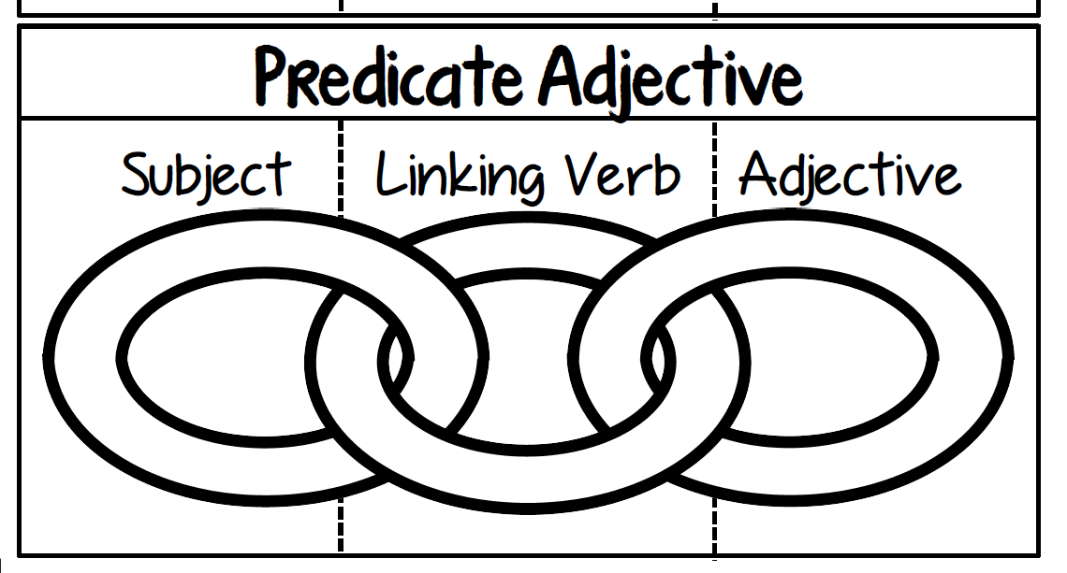
I
was
tired.

Slide 7
Predicate Adjective
An adjective that follows the linking verb and describes the subject

Slide 8
linking verb
The orange cat is crazy.
predicate adjective
subject
The cat is WHAT?
linking verb
The goofy clown was funny.
predicate adjective
subject
The clown was WHAT?

Slide 10
My headache became worse.
Charlie seems upset about his grades.
Baton Rogue is the capital of Louisiana.

Slide 11
4. The platypus is a mammal.
5. This lesson was easy.
6. John is the president of Student Council.

Slide 13
Color code.

