Slide 1
Non-Fiction Text Structure

Slide 2
Non-Fiction Text Structure
How is information organized?
Compare and Contrast
Order and Sequence
Problem and Solution
Cause and Effect

Slide 3
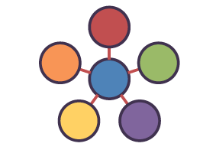
Description
the author provides several details of something to give the reader a mental picture

Slide 4
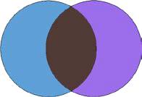
Compare and Contrast
the author discusses similarities and differences between people, things, concepts, or ideas
likenesses and differences are discussed
uses words such as: also, both, in contrast, similarly

Slide 5
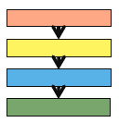
Order and Sequence
The author provides readers with chronological events or a list of steps in a procedure
events in order of occurrence
instructions given step by step
uses words such as: first, and next (order words)

Slide 6
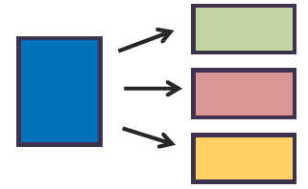
Problem and Solution
The author gives information about a problem and explains one or more solutions
a problem is solved or needs solving
uses words such as: problem, solution, solve

Slide 7
Cause and Effect
The author describes an event or several events (cause) and the events that follow (effect)
uses words such as: cause, because, as a result of, due to, reason

