Slide 1
Nonfiction Text Structure
Day 4

Slide 2
Nonfiction Text Structure
How is information organized?
Compare and Contrast
Order and Sequence
Problem and Solution
Cause and Effect

Slide 3
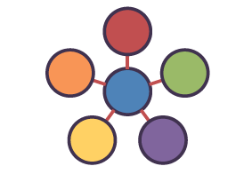
Description
the author provides several details of something to give the reader a mental picture

Slide 4
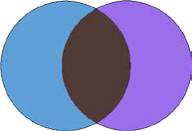
Compare and Contrast
the author discusses similarities and differences between people, things, concepts, or ideas
likenesses and differences are discussed
uses words such as: also, both, in contrast, similarly

Slide 5
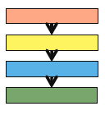
Order and Sequence
The author provides readers with chronological events or a list of steps in a procedure
events in order of occurrence
instructions given step by step
uses words such as: first, and next (order words)

Slide 6
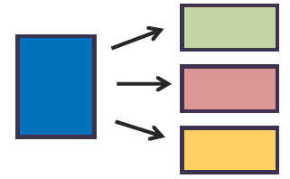
Problem and Solution
The author gives information about a problem and explains one or more solutions
a problem is solved or needs solving
uses words such as: problem, solution, solve

Slide 7
Cause and Effect
The author describes an event or several events (cause) and the events that follow (effect)
uses words such as: cause, because, as a result of, due to, reason

Slide 8
What is a glossary?
Glossary: An alphabetical list that appears at the end of a text. The glossary defines terms within that book that are either newly introduced, uncommon, or specialized.
Index: An index can also be found in the back of the book with names, terms, and subjects and gives the pages numbers these terms are found on.

Slide 9
Practice
What type of structure does “Good News for Monarchs” use?
Directions: Read the included passages and fill out the corresponding graphic organizer.

