Slide 1
“Names Nombres”

Slide 2
usher verb
to introduce or make known the presence or arrival of someone

Slide 3

surname noun
someone’s family name; generally a last name

Slide 4
specify verb
to make known or identify

Slide 5
merge verb
to blend together

Slide 6
initial adjective
occurring at the first or beginning

Slide 7
ironic adjective
contrary to what is intended or expected

Slide 8
inevitable adjective
impossible to avoid or prevent

Slide 9
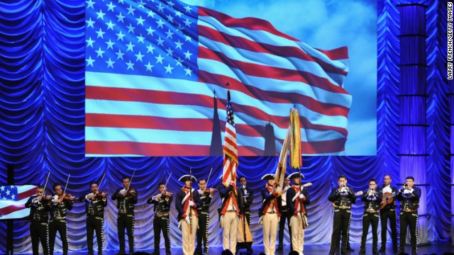
heritage noun
a way of life or tradition passed down from generation to generation

Slide 10
exotic adjective
unusual or different

Slide 11
ethnicity noun
racial, national, or cultural heritage

Slide 12
convoluted adjective
difficult to understand; complicated

Slide 13
chaotic adjective
confused; disorder

