Slide 1
Non-Fiction /
Informational Texts
Day 1

Slide 2
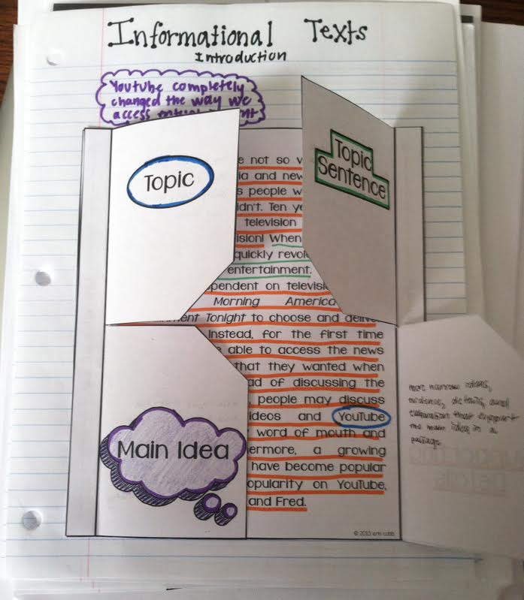
Bellringer
Cut out and glue the foldable into your ISN so it looks like this:
Put page number and “Informational
Texts Introduction”into your table of
contents
Get 4 different colored writing utensils
Glue “How to Determine the Main Idea”
into your notebook and label in your
table of contents

Slide 3
What is non-fiction?
Non-fiction text: literature that addresses true information
Informs, teaches, and explains
Also called informational texts

Slide 4
What is the topic of a piece of non-fiction?
Topic: the general subject that the passage is about, usually one or two words
Topic Sentence: a sentence in a passage that states the main idea of that passage
This is not always the first sentence in a passage

Slide 5
What is the main idea of a piece of non-fiction?
Main Idea: a statement that tells what a passage is mostly about
This is not always stated outright in the passage. The reader determines this after reading and comprehending
Supporting Details: more narrow ideas, evidence, details, and elaboration that support the main idea in a passage

Slide 6
How do you determine the main idea?
Can you name a person, place, idea, event, or thing the article focuses on?
What words or ideas are really stressed?
Overall, what did you learn while reading the passage?
How would you tell a friend about the passage in one sentence?

Slide 7
Example
Circle the topic in blue
Put a box around the topic sentence in green
Write the main idea underneath the passage and put a purple bubble around it
Underline supporting details in orange

Slide 8
Practice with a Partner
Read the article with a partner
Circle the topic
Put a box around the topic sentence
Underline the supporting details
Write a sentence about the main idea on your paper under the article

