Slide 1
What is a Genre?

Slide 2
Genre
Genre is a French word meaning “type or category.”
We use genres as a way to categorize books and texts.
A genre is a type of book.

Slide 3
Fiction
fake; not real
Fiction genres can be divided into different categories:

Slide 4
Realistic Fiction
Set in the present with people or events that could happen, but aren’t real
Everyday people doing everyday things, but they are not real.
Characteristics: characters going to school, characters talking on cell phones, etc.

Slide 5
Examples of Realistic Fiction

Slide 6
Historical Fiction
Set in the past during real historical events
The story contains made up characters and plots
Characteristics: fictional soldiers during WWII, made up character meets President Lincoln

Slide 7
Examples of Historical Fiction

Slide 8
Science Fiction
Things that are not possible now but could be possible in the future
Characteristics: space, time travel, clones, robots, aliens

Slide 9
Examples of Science Fiction

Slide 10
Fantasy
Events or characters that are not real or not possible
Make believe and magic are involved
Characteristics: talking animals, medieval times, dragons

Slide 11
Examples of Fantasy

Slide 12
Folk Tales
A story that has been passed down from generation to generation by word of mouth

Slide 13
Legends
A story handed down from the past usually about someone with heroic accomplishment

Slide 14
Myths
A traditional story that attempts to answer basic questions about human nature, mysteries of nature, or origins of the world

Slide 15
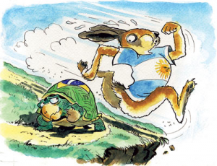
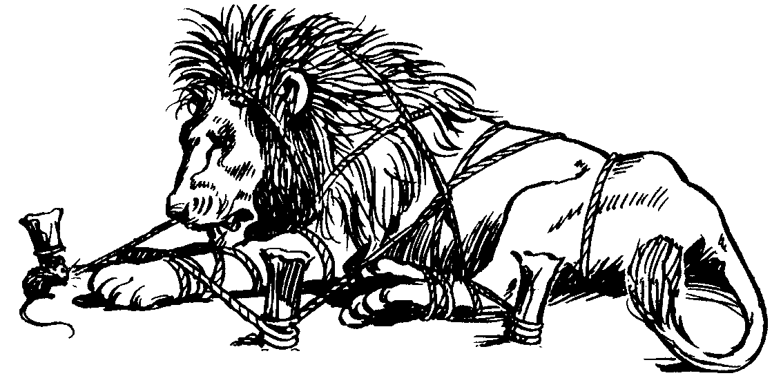
Fable
A brief tale told to illustrate a moral or teach a lesson

Slide 16
Tall Tale
A humorous, exaggerated story about impossible events and the supernatural abilities of the main character

Slide 17
Drama
A form of literature meant to be performed by actors on stage in front of an audience
Characteristics:
comedy
tragedy

Slide 18
Examples of Drama

Slide 19
Nonfiction
Writing that tells about real people, places, and events
Nonfiction can be divided into categories:

Slide 20
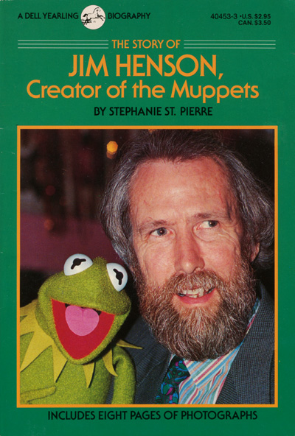
Biography
A true account of a person’s life written by another person

Slide 21
Autobiography
A writer’s account of his or her own life

