Slide 1
Freak the Mighty
Vocabulary List 2

Slide 2
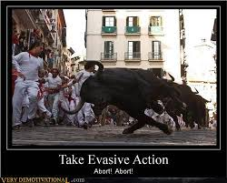
1. evasive - adjective
avoiding something or someone

Slide 3
2. incision – noun
a cut made by a surgical knife

Slide 4
3. smug - adjective
full of yourself

Slide 5
4. vegetate - verb
to waste time doing nothing

Slide 6
5. intruding - verb
to force in without invitation or right

Slide 7
6. modification - noun
a change to make something better

Slide 8
7. optimum - adjective
at the highest possible level; best possible

Slide 9
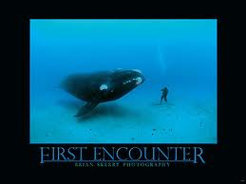
8. encounter - verb
to meet unexpectedly

Slide 10
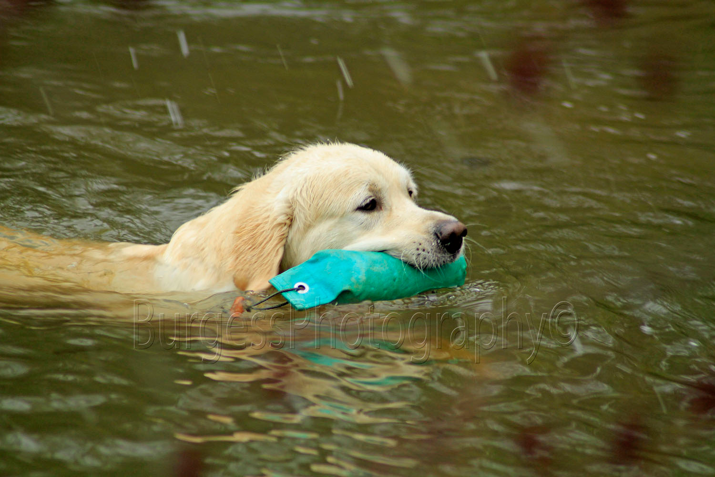
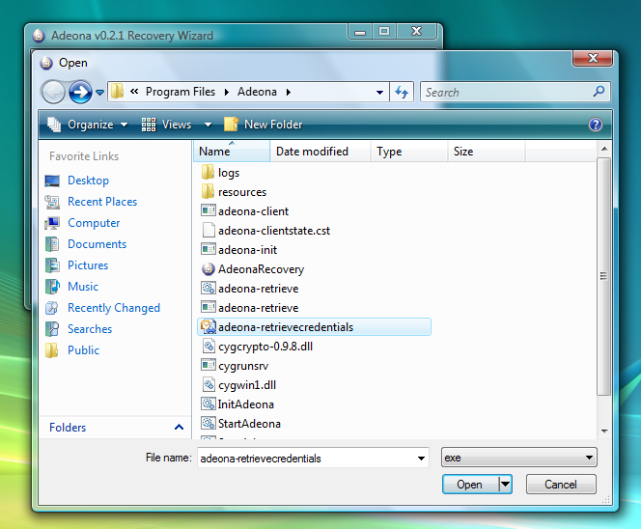
9. retrieve - verb
to get something that was lost, misplaced, or moved

Slide 11
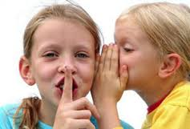
10. divulge - verb
to tell information that's supposed to be secret

Slide 12
HOMEWORK
Write 5 compound sentences with 5 vocabulary words.
Write 5 complex sentences with the OTHER 5 words.
Use your notebook to review sentence structure.

Slide 13
REVIEW SLIDES

Slide 14
1. evasive - adjective
avoiding something or someone

Slide 15
2. incision – noun
a cut made by a surgical knife

Slide 16
3. smug - adjective
full of yourself

Slide 17
4. vegetate - verb
to waste time doing nothing

Slide 18
5. intruding - verb
to force in without invitation or right

Slide 19
6. modification - noun
a change to make something better

Slide 20
7. optimum - adjective
at the highest possible level; best possible

Slide 21
8. encounter - verb
to meet unexpectedly

Slide 22
9. retrieve - verb
to get something that was lost, misplaced, or moved

Slide 23
10. divulge - verb
to tell information that's supposed to be secret

