Slide 1
Freak the Mighty
Vocabulary list 1

Slide 2
1. phony - adjective
not genuine; giving a false impression

Slide 3
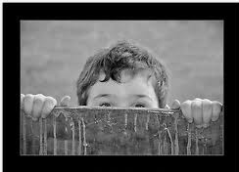
2. glimpse – noun
noun - a brief look

Slide 4
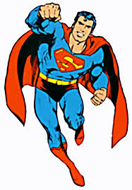
3. invincible - adjective
describes a person who can't be beaten

Slide 5
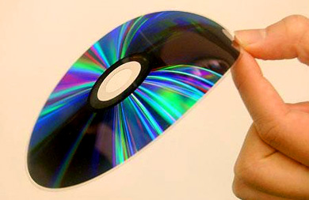
4. flimsy - adjective
weak; easily broken or torn
unconvincing (difficult to believe or accept)

Slide 6
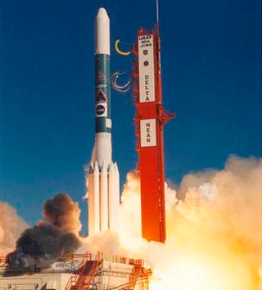
5. propulsion - noun
the moving force behind something

Slide 7
6. cretin - noun
an offensive term for someone considered unintelligent

Slide 8
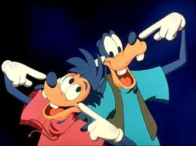
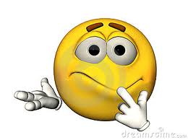
7. demeanor - noun
outward behavior; the way someone acts

Slide 9
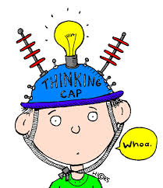
8. postulate - verb
to assume based on an argument or theory

Slide 10
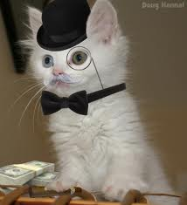
9. sophisticated - adjective
knowing a lot about the world; having fancy tastes and ideas

Slide 11
10. illiterate - adjective
not being able to read or write

Slide 12
HOMEWORK
Choose 5 vocabulary words.
Draw or find a picture to illustrate the words.
Bring to class tomorrow. A partner will guess the vocabulary word based on your illustration.

Slide 13
REVIEW SLIDES

Slide 14
1. phony - adjective
not genuine; giving a false impression

Slide 15
2. glimpse – noun
a brief look

Slide 16
3. invincible - adjective
describes a person who can't be beaten

Slide 17
4. flimsy - adjective
weak; easily broken or torn
unconvincing (difficult to believe or accept)

Slide 18
5. propulsion - noun
the moving force behind something

Slide 19
6. cretin - noun
an offensive term for someone considered unintelligent

Slide 20
7. demeanor - noun
outward behavior; the way someone acts

Slide 21
8. postulate - verb
to assume based on an argument or theory

Slide 22
9. sophisticated - adjective
knowing a lot about the world; having fancy tastes and ideas

Slide 23
10. illiterate - adjective
not being able to read or write

