Slide 1
The Elements of Drama
7th Grade Language Arts

Slide 2
Drama
Comes from the Greek Word, “Dran,” which means “To do” or “To Act”
The doing & acting make Drama.

Slide 3
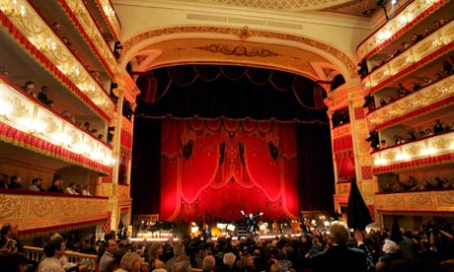
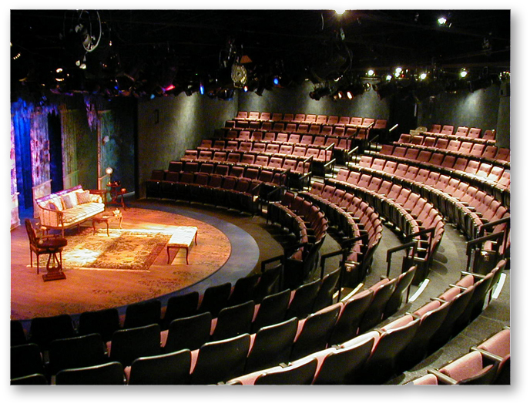
Drama is a story told in front of an audience.

Slide 4
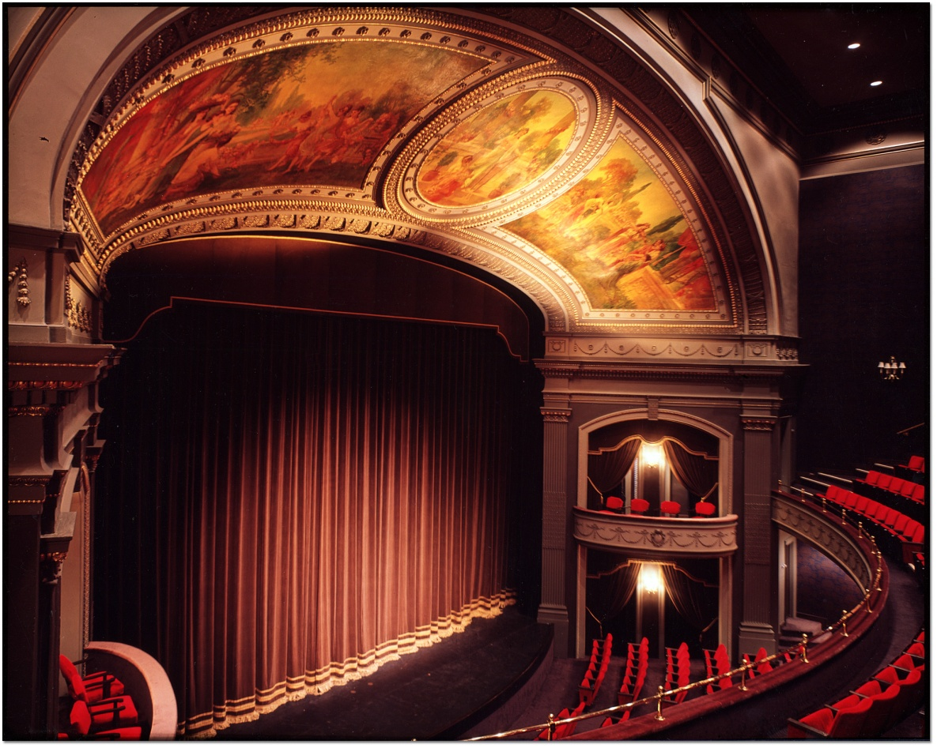
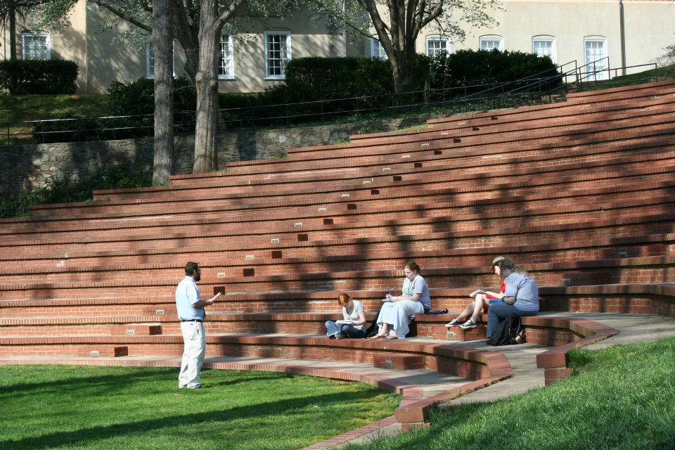
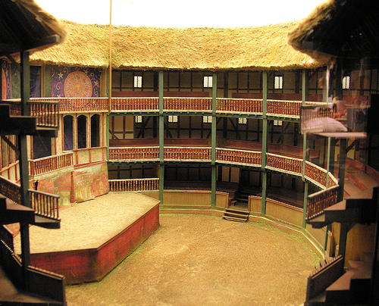
A theatre is where a play takes place.

Slide 5
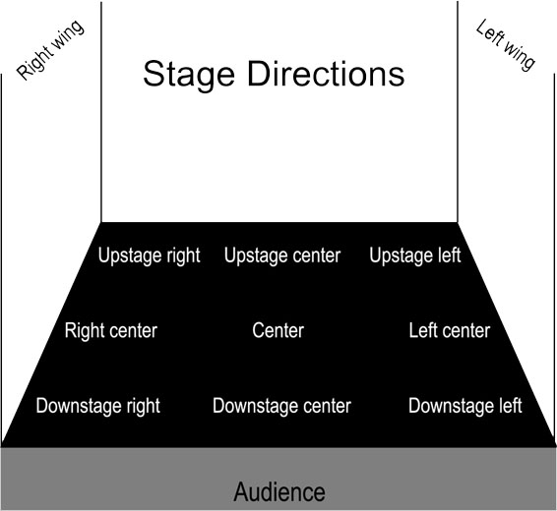
Stage Directions tell where on stage the action takes place.
Also describe scenery & how characters speak
Found in brackets [ ]
C = Center Stage
L = Stage Left
R = Stage Right
U = Upstage or Rear
D = Downstage or Front

Slide 6
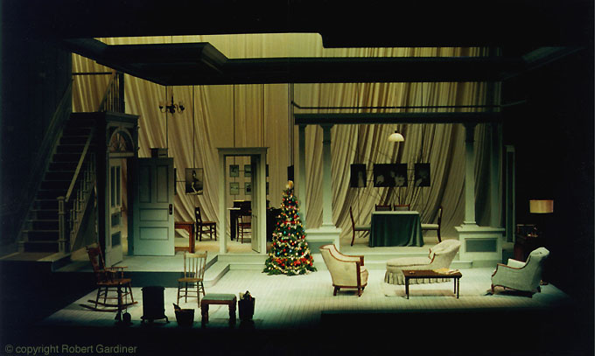
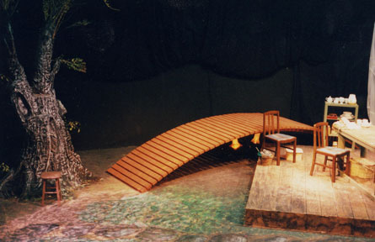
The set is construction on the stage that shows the time & place.
Can also be called scenery in a play.

Slide 7
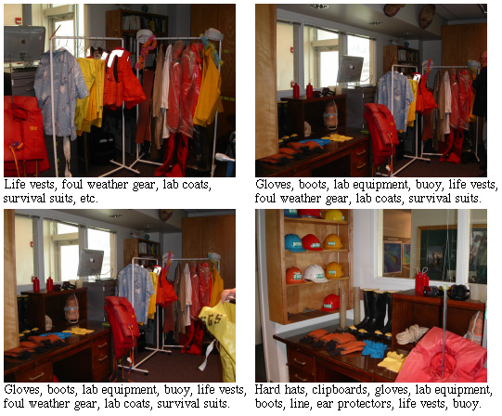
Props are the small movable items that actors use to make actions look real.

Slide 8
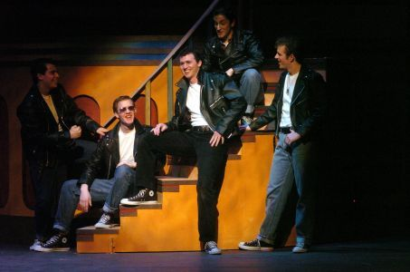
Elements of Drama
Playwright – the author of a play
Actors – the people who perform

Slide 9
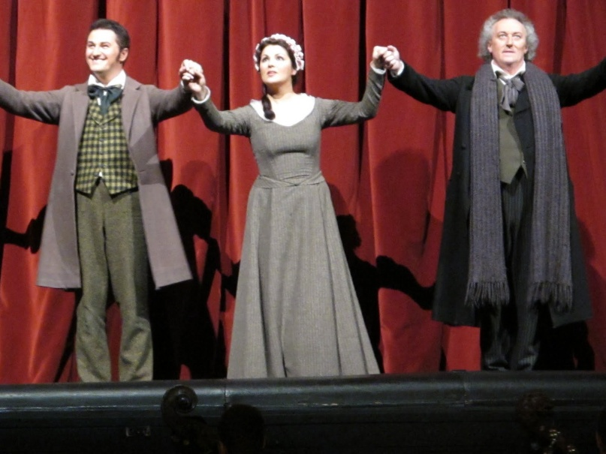
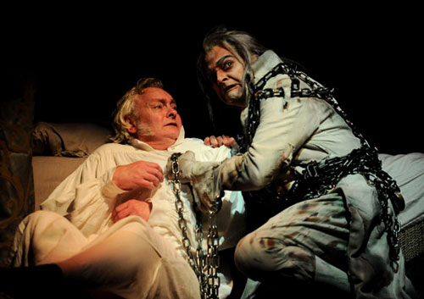
Elements of Drama
Scenes – make up the acts
Acts – the units or division of a play, which is made up of one or more scene.

Slide 10
Dramatic Speech
Mono: Dia:
Monologue –
long speech by one single character (private thoughts)
Dialogue – conversation between or among characters

Slide 11
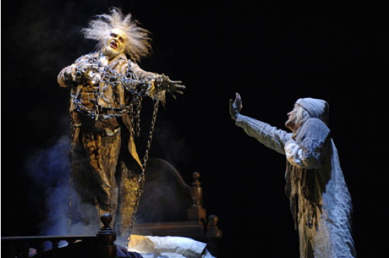
Conflict
The internal or external struggle between opposing forces, ideas, or interests that create dramatic tension.

Slide 12
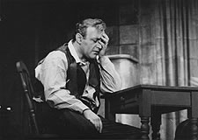
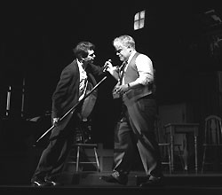
Types of Drama
Drama is the term used to describe plays that address a serious subject.

Slide 13
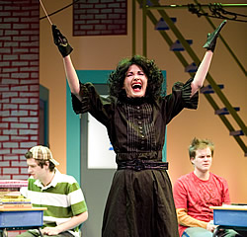
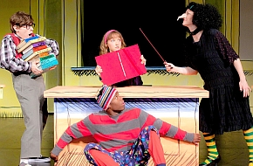
Types of Drama
Comedy is a form of drama that has a happy ending. Humor comes from the dialogue and situations.

Slide 14
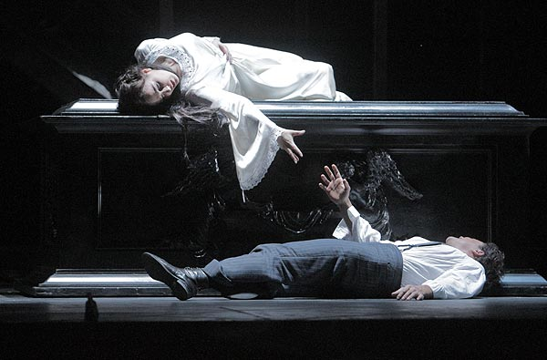
Types of Drama
Tragedy is a form of drama in which events lead to the downfall of the main character, often a person of great significance, like a king or hero.

