Slide 1
Informational Text
Day 2

Slide 2
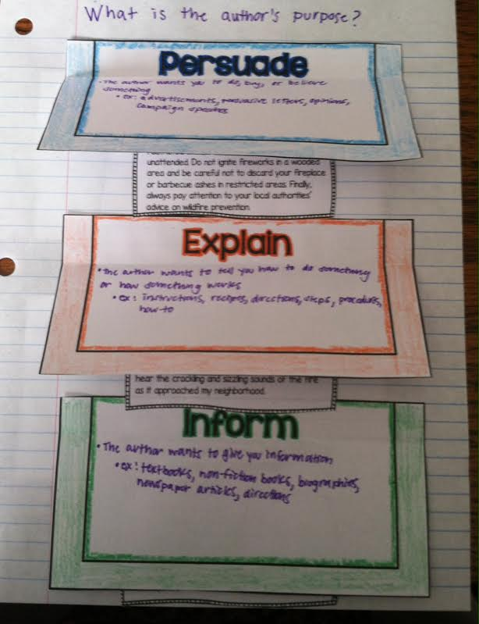
Bell Work
Cut out and glue the foldable into your ISN so it looks like this (it will take up 2 pages):
Put page number and “Author’s Purpose”
into your table of contents
Cut out each example card
We will glue the example cards under
each author’s purpose later today

Slide 3
What is the author’s purpose?
Persuade
Inform
Entertain
Explain
Describe

Slide 4
Author’s Purpose: To Persuade
Persuade: the author wants you to do, buy, or believe something
advertisements, persuasive letters, opinions, campaign speeches
If the author’s purpose is to persuade, can we believe everything they write to be a fact?

Slide 5
Author’s Purpose: To Inform
Inform: the author wants to give you information
textbooks, non-fiction books, biographies, newspaper articles

Slide 6
Author’s Purpose: To Entertain
Entertain: the author wants to amuse you or for you to enjoy the writing
This purpose is not exclusive to non-fiction literature.
fiction stories, poems, songs, plays, narratives, memoirs

Slide 7
Author’s Purpose: To Explain
Explain: the author wants to tell you how to do something or how something works
instructions, directions, steps, procedures, how-to, recipes

Slide 8
Author’s Purpose: To Describe
Describe: the author wants you to visualize or experience a person, place, or thing
product descriptions, descriptive essays

Slide 9
Examples
Look at each example and decide if the author’s purpose is to persuade, inform, entertain, explain, or describe.

Slide 10
Examples
Re-read the “Good News for Monarchs” Article
What is the author’s purpose?
Write the author’s purpose on the bottom of the page
Check your answer with the person sitting next to you
Based on the author’s purpose, is the information in “Good News for Monarchs” reliable?

