Slide 1
“Daring Dicey”
Vocabulary

Slide 2
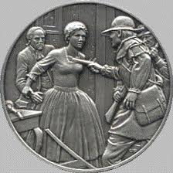
heroine noun
a woman known for courage and
daring action

Slide 3
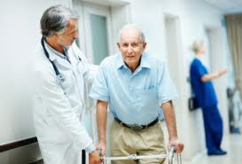
infirmities noun
Weakness of body usually from old
age or disease

Slide 4
incensed verb
To cause to be
extremely angry

Slide 5
retribution noun
punishment that is considered
to be fully deserved

Slide 6
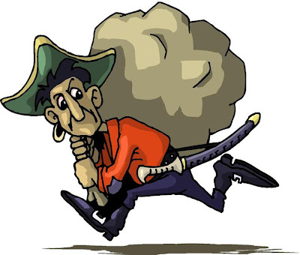
plunder verb
to take something by force;
steal

Slide 7
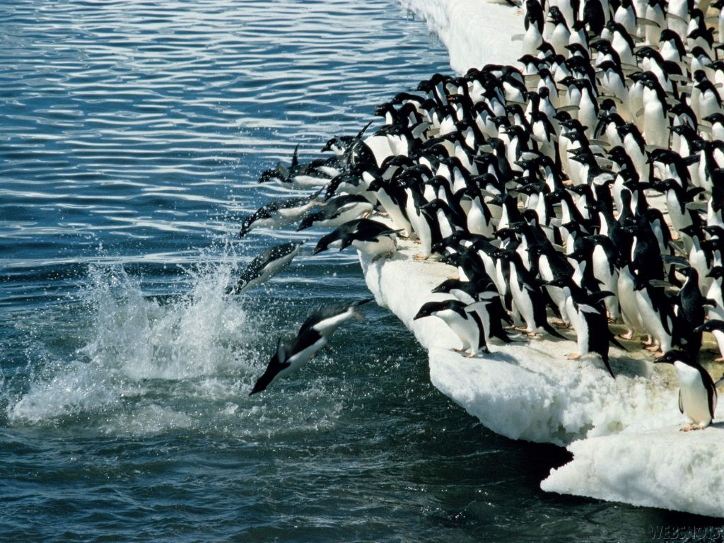
plunged verb
to move forcefully toward

Slide 8
excursion noun
a journey or trip

Slide 9
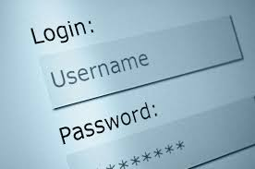
countersign noun
A password

Slide 10
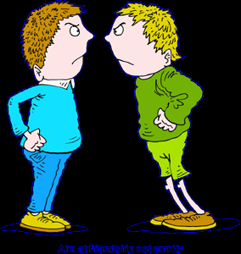
enmity noun
feeling of hatred

Slide 11
prosperous adjective
successful, well-off
prosperity = noun

