Slide 1
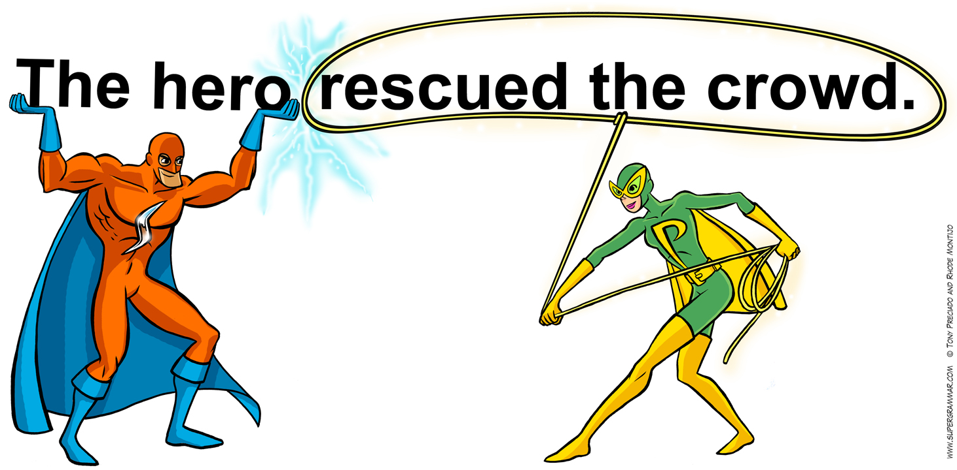
Subjects and Predicates

Slide 2
What two parts make up a sentence?
SUBJECT
+
PREDICATE

Slide 3
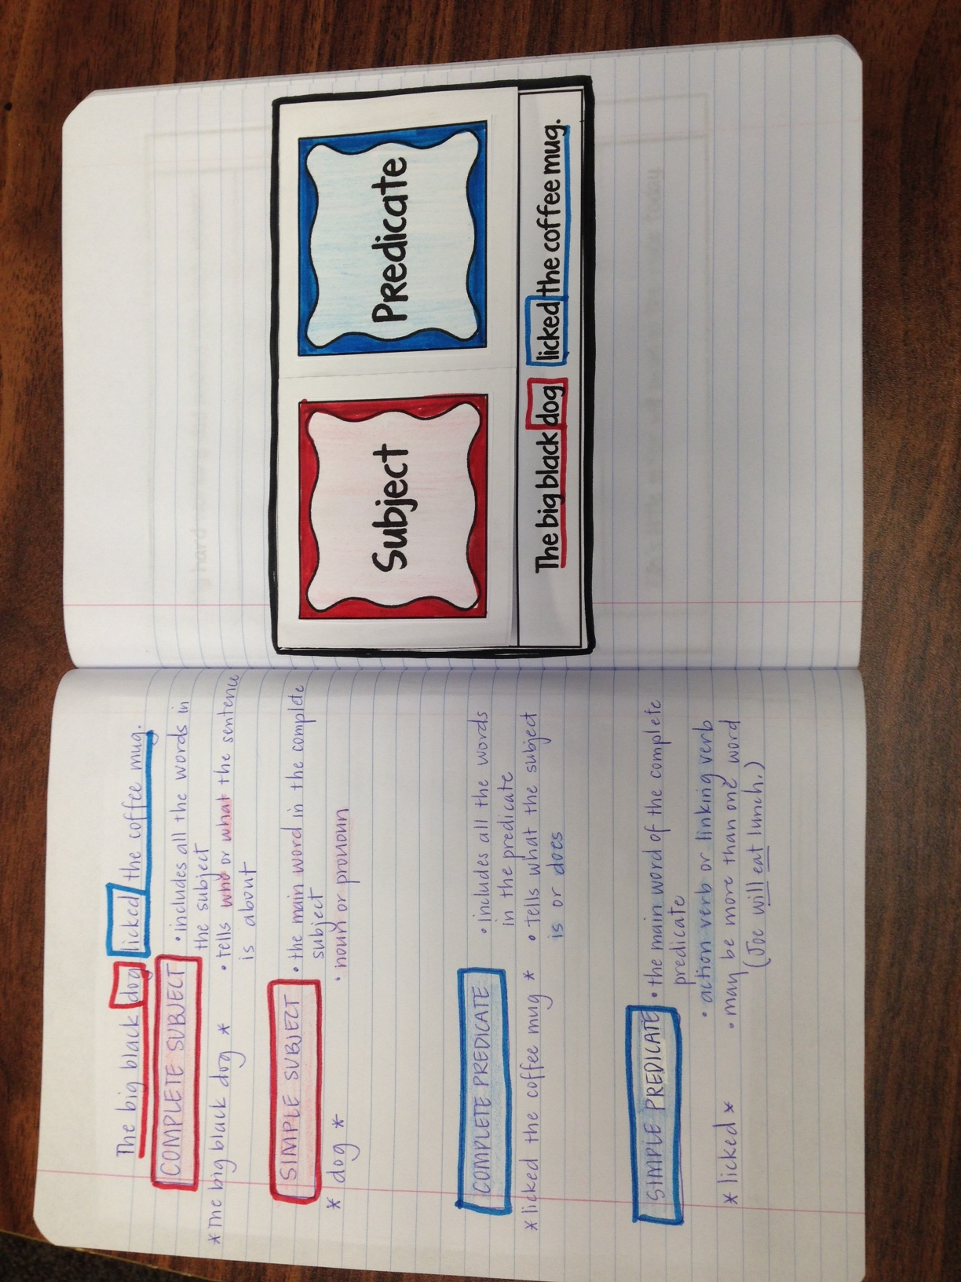

Slide 4
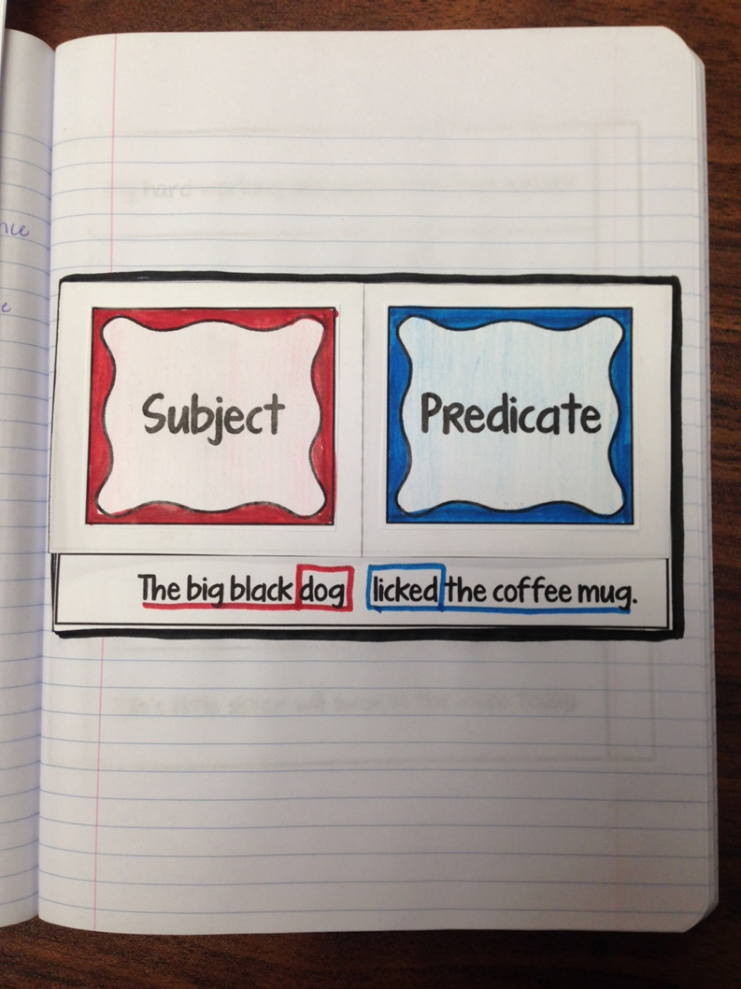

Slide 5
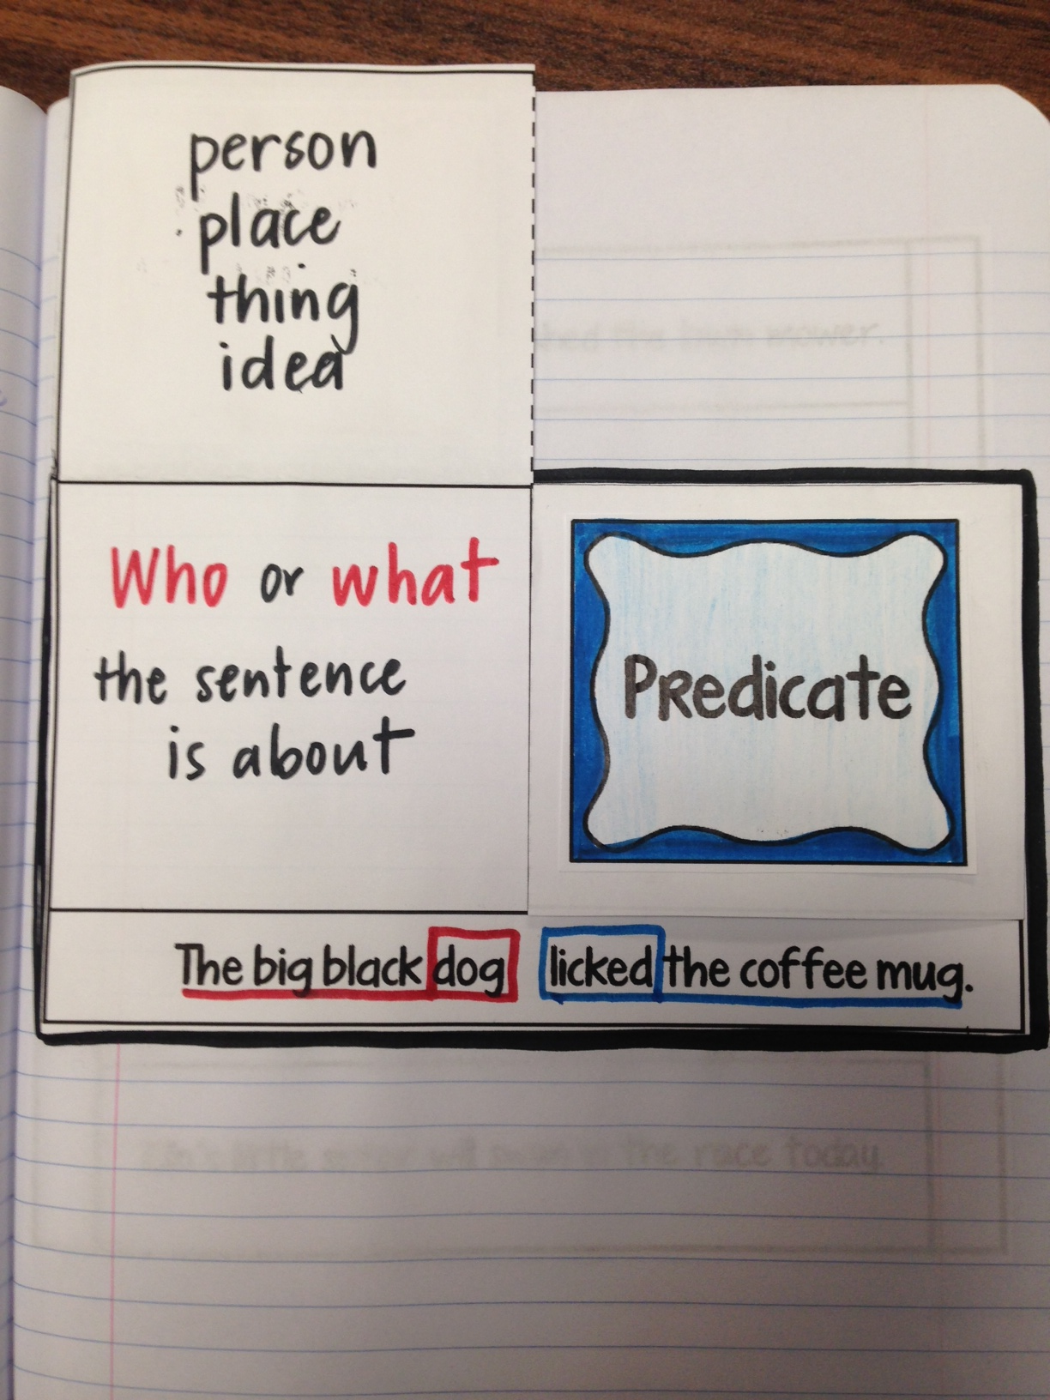
Complete Subject
person, place, thing, or idea
WHO or WHAT the sentence is about

Slide 6
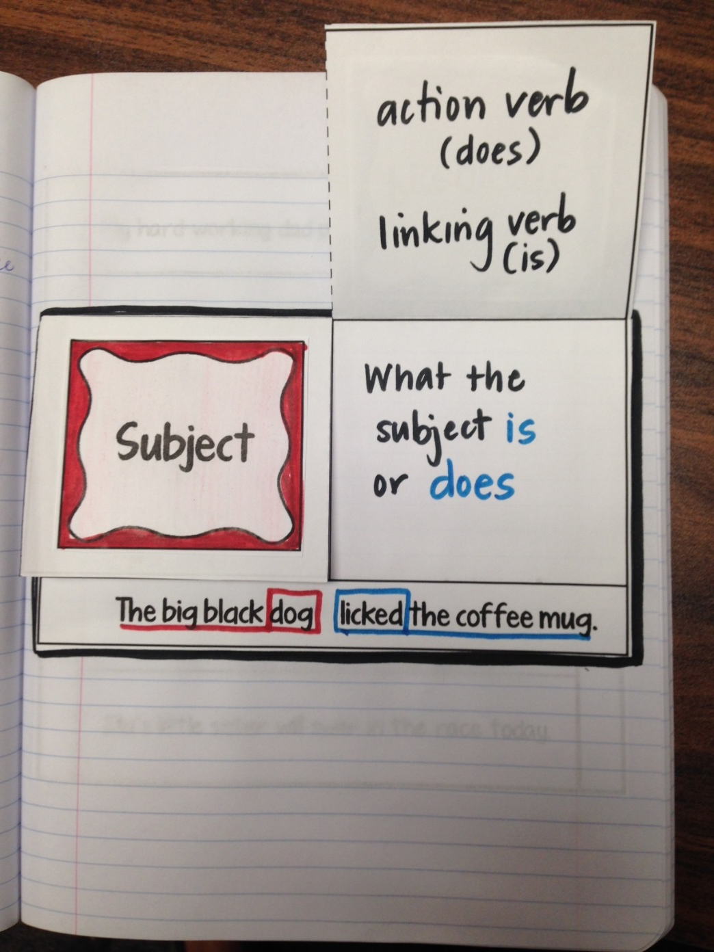
Complete Predicate
action verb (does)
linking verb (is)
what the subject IS or DOES

Slide 7
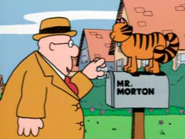
http://www.youtube.com/watch?v=fdUXxdmhIsw

Slide 8
Practice
Mister Morton walked down the street.
Mister Morton walked down the street.
Mister Morton talked to his cat.
Mister Morton talked to his cat.

Slide 9
Practice
Mister Morton was lonely.
Mister Morton was lonely.
Mister Morton knew just one girl.
Mister Morton knew just one girl.

Slide 10
Practice
Mister Morton grew flowers for Pearl.
Mister Morton grew flowers for Pearl.
Mister Morton was very shy.
Mister Morton was very shy.

Slide 12
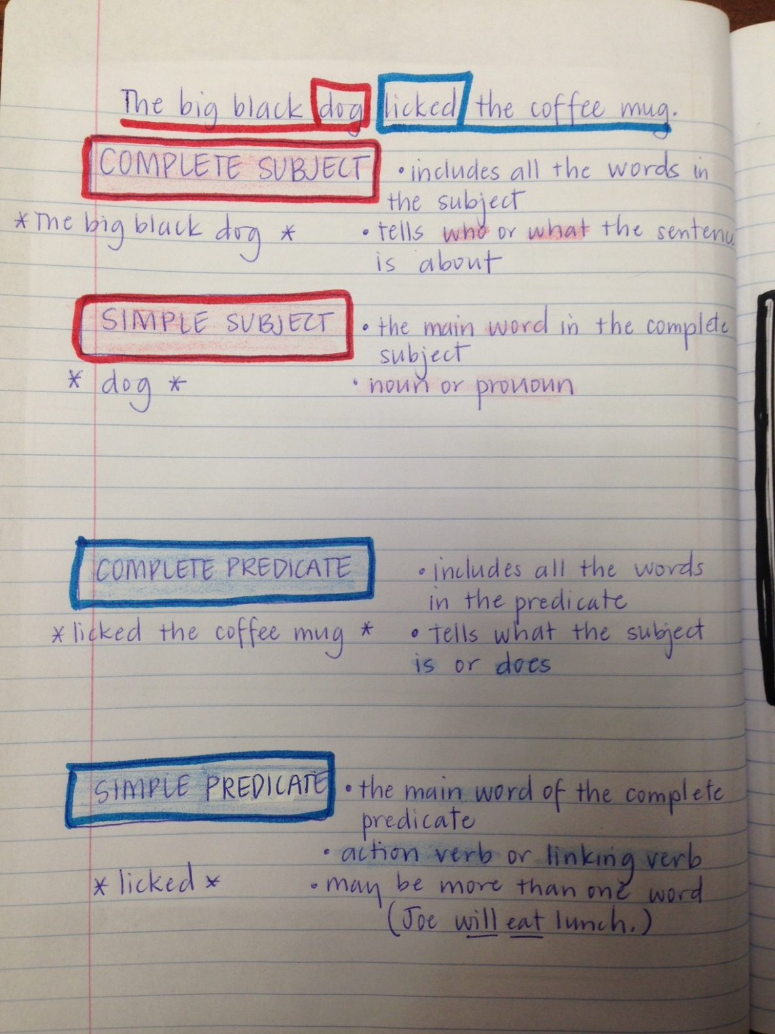

Slide 13
The big black dog licked the coffee mug.
Complete Subject
The big black dog
includes all the words in the subject
tells who or what the subject is about
the main word in the complete subject
a noun or pronoun
Simple Subject
dog

Slide 14
The big black dog licked the coffee mug.
includes all the words in the predicate
tells what the subject is or does
the main word in the complete predicate
an action verb or linking verb
may be more than one word
(Joe will eat lunch.)
Complete Predicate
licked the coffee mug.
Simple Predicate
licked

