Slide 1
Outsiders Vocabulary Chapters 3 - 4
Sophisticated – experienced in the ways of the world, self-confident, and not easily deceived (adj)
Aloofness – the state of being uninterested (noun)
Elite – superior; at the top of society or a group (noun)
Gallantly – courageous or bold; self sacrificing (adv)
Ember – a glowing piece of wood, coal, etc. (noun)
Apprehensive – anxious or fearful; uneasy (adj)
Defiance – bold resistance to authority (noun)
Contemptuous – scornful; despising (adj)
Sheepish – acting embarrassed or ashamed (adj)
Premonition – a feeling that something is about to occur with no forewarning (noun)

Slide 2
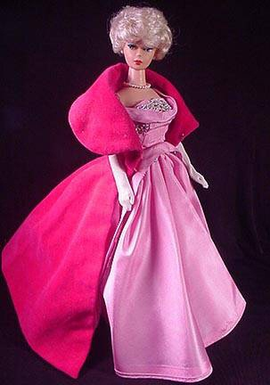
sophisticated
adj – experienced in
the ways of the world;
self-confident; not easily
deceived
She was a sophisticated woman who traveled a great deal and was knowledgeable about world affairs.

Slide 3
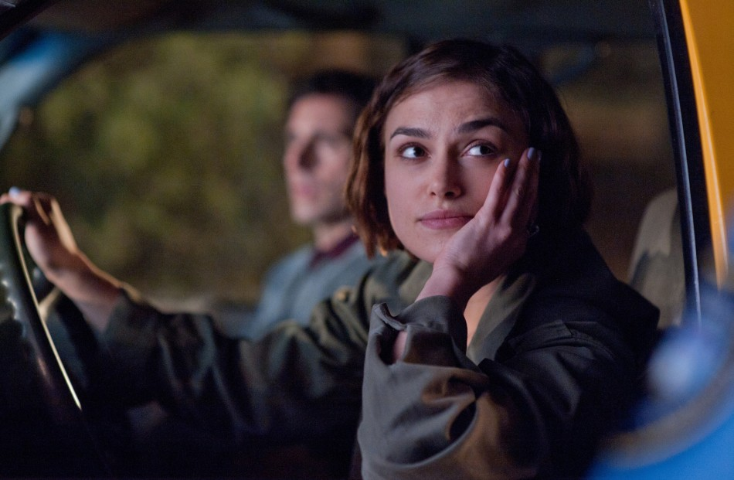
aloofness
noun – the state of
being uninterested
She seemed distracted, and her aloofness made him think that she really didn't want to go out with him.

Slide 4
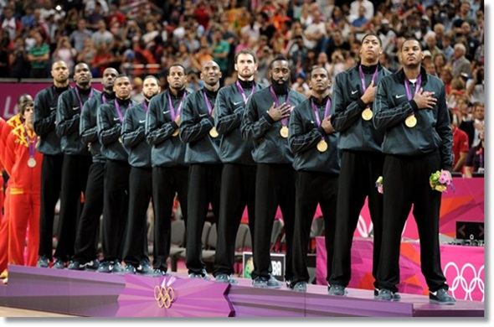
elite
noun – superior;
at the top of
society or a group
Because of their winning streak during the Olympics, the US basketball team emerged as an elite team.

Slide 5
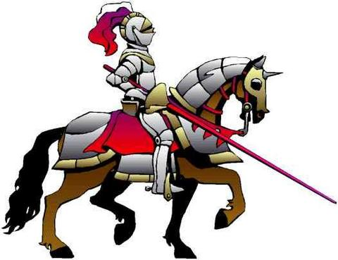
gallant
adj - courageous
or bold;
self sacrificing
The gallant knight in shining armor defended the castle against the enemy’s attack.

Slide 6
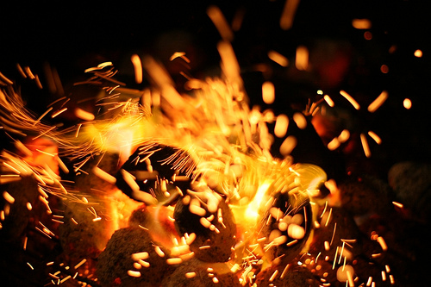
ember
noun – a glowing
piece of coal or
wood
The ember glowed brightly in the fading firelight.

Slide 7
apprehensive
adj – anxious or fearful;
uneasy
On my first day of my new job, I was feeling quite apprehensive.

Slide 8
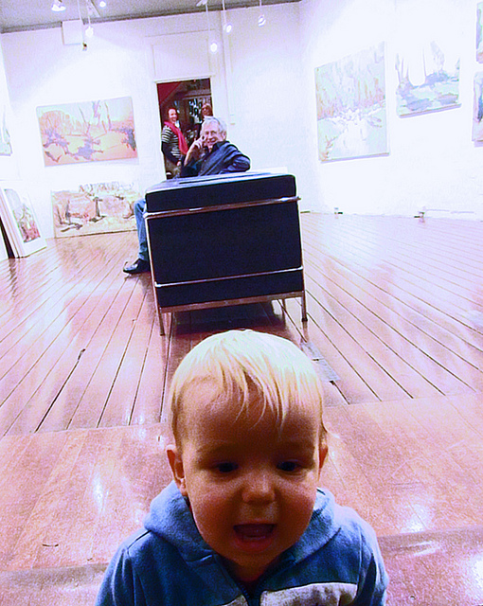
defiance
noun – bold resistance
to authority
After being kept in a stroller all morning, the restless toddler ran away from his father in a gesture of defiance.

Slide 9
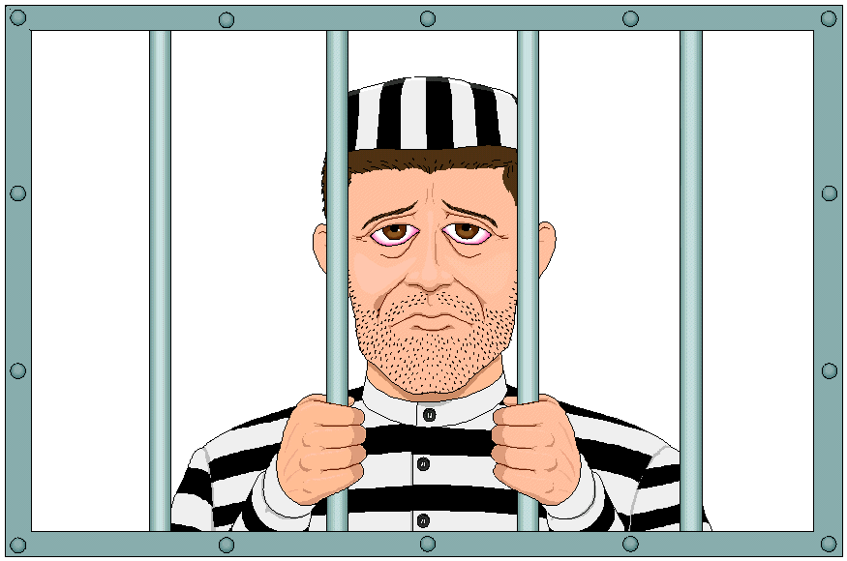
contemptuous
adj – scornful;
despising
Due to his contemptuous behavior, the judge gave the defendant a tougher jail sentence.

Slide 10
sheepish
adj – acting embarrassed
or ashamed
A sheepish grin broke across Nate’s face when he realized the surprise party was for him.

Slide 11
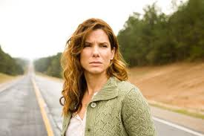
premonition
noun – a feeling that
something is about
occur with no forewarning
“I'm not saying I’m psychic, of course, but sometimes I do have strong premonitions about the future,” said Jane.

Slide 12
Vocabulary Review

Slide 13
adj – experienced in
the ways of the world;
self-confident; not easily
deceived

Slide 14
noun – the state of
being uninterested

Slide 15
noun – superior;
at the top of
society or a group

Slide 16
adj - courageous
or bold;
self sacrificing

Slide 17
noun – a glowing
piece of coal or
wood

Slide 18
adj – anxious or fearful;
uneasy

Slide 19
noun – bold resistance
to authority

Slide 20
adj – scornful;
despising

Slide 21
adj – acting embarrassed
or ashamed

Slide 22
noun – a feeling that
something is about
occur with no forewarning

