Slide 1
A Christmas Carol
Charles Dickens

Slide 2
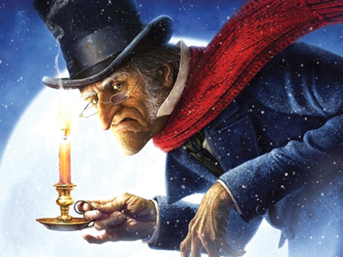
humbug - interjection
nonsense

Slide 3
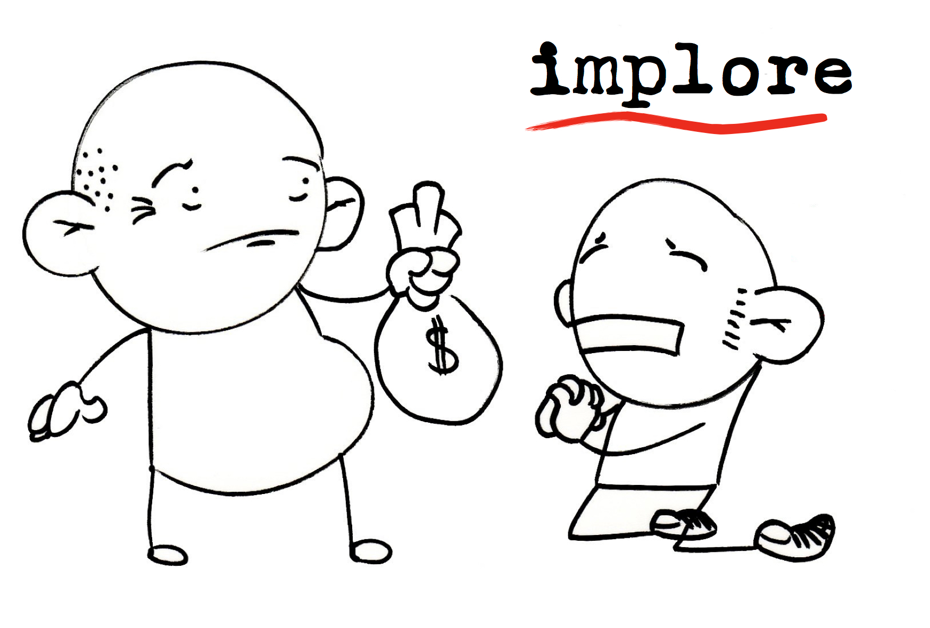
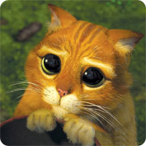
implore - verb
to beg

Slide 4
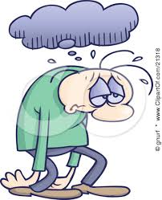
morose - adjective
ill-tempered; gloomy

Slide 5
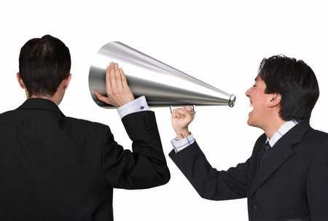
conveyed - verb
made known; expressed

Slide 6
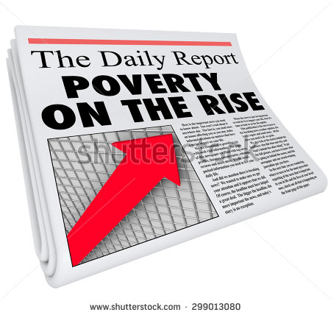
destitute - adjective
used to describe people living in poverty

Slide 7
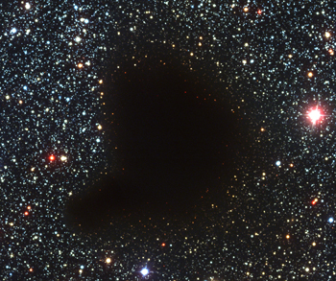
void – noun
emptiness

Slide 8
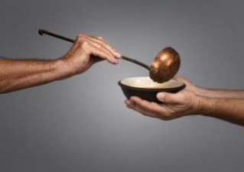
benevolence - noun
kindness

Slide 9
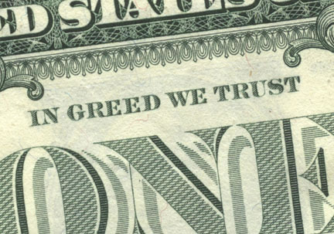
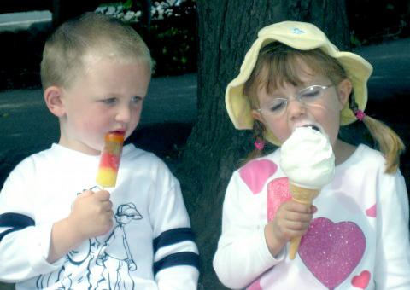
covetous - adjective
having a desire to possess something belonging to someone else

Slide 10
benefactor - noun
a person who gives money or other help to a person or cause

Slide 11
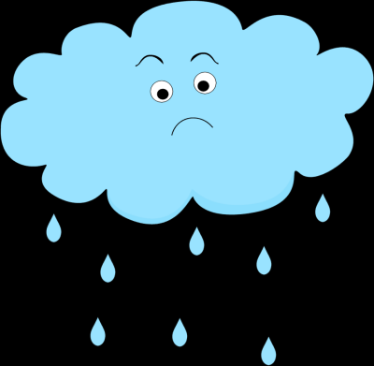
melancholy - adjective
sad; sorrowful; unhappy

