Slide 1
Poetry Elements
6th grade

Slide 2
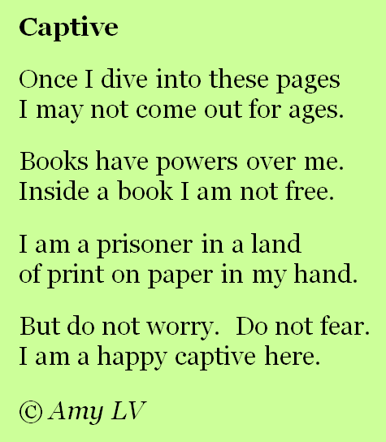
couplet
A two line stanza that rhymes

Slide 3
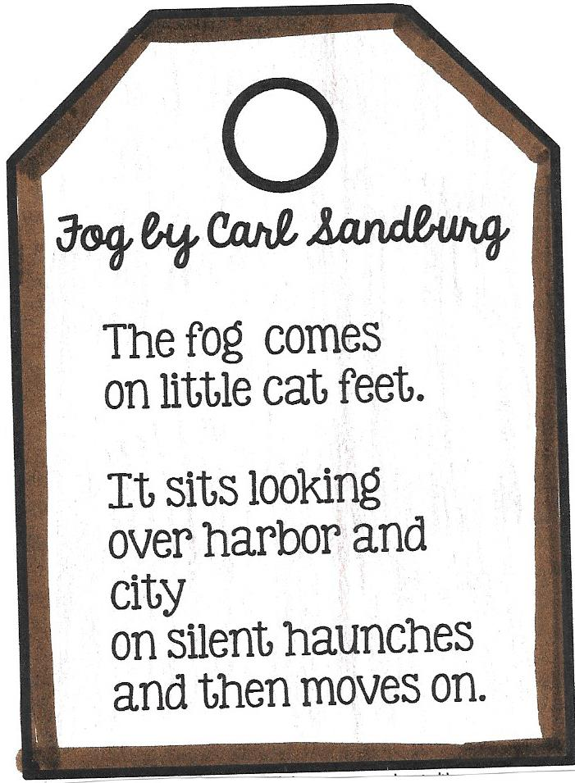
free verse
Poetry that does not
follow a specific form
and does not have
to rhyme.

Slide 4
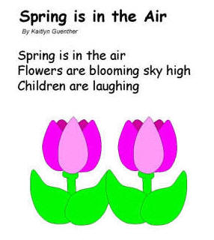
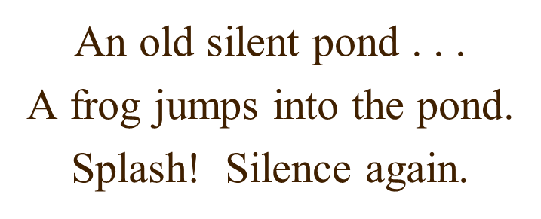
haiku
A Japanese poetry form
written in 3 lines with
17 syllables arranged
in lines of 5-7-5; typically
about nature

Slide 5
imagery
the use of words to create pictures or images in your head; appeals to the 5 senses

Slide 6
internal rhyme
words in the same line that rhyme

Slide 7
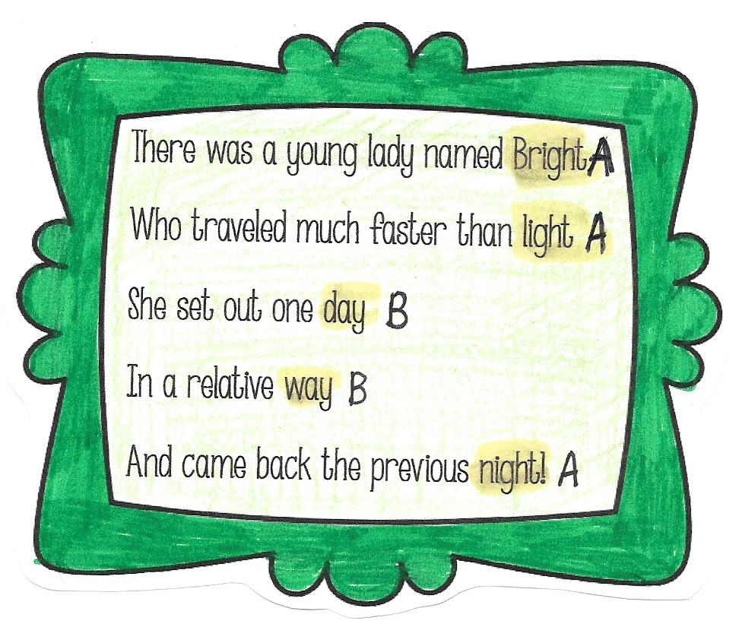
limerick
a humorous 5 line poem
with a definite rhyme
scheme of A A B B A

Slide 8
lines
a group of words together on one line of the poem.

Slide 9
lyric poetry
a short poem that expresses emotions and feeling; often musical and written in first person.

Slide 10
narrative poetry
poems that tell a story with a plot, characters, and a setting

Slide 11
poetry
a type of literature that expresses ideas, feelings or tells a story in a specific form (usually using lines and stanzas).

Slide 12
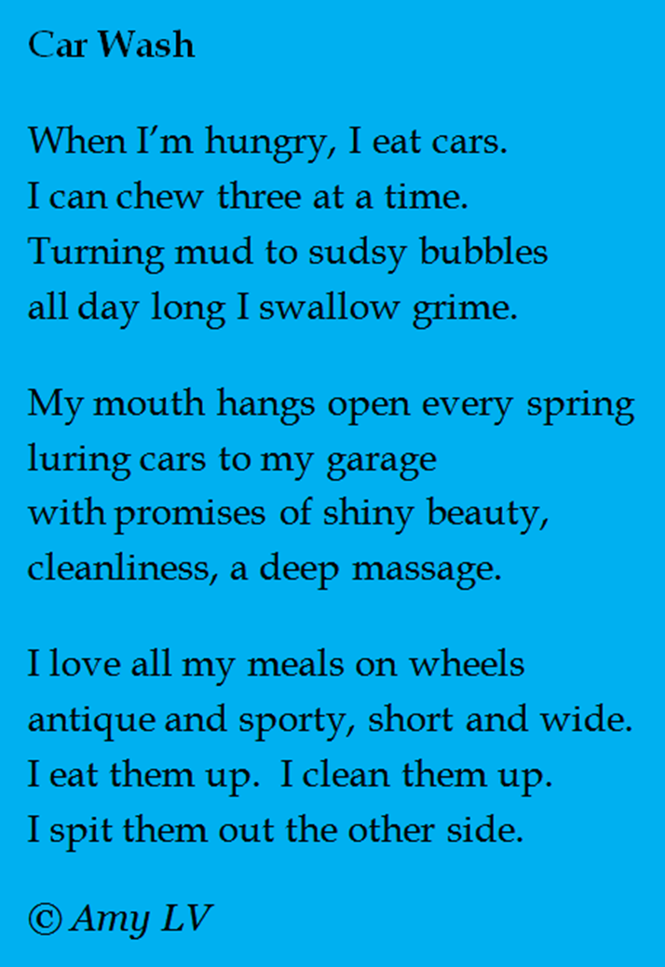
quatrain
a four line stanza

Slide 13
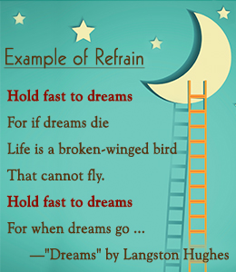
refrain
one or more lines
repeated in each stanza

Slide 14
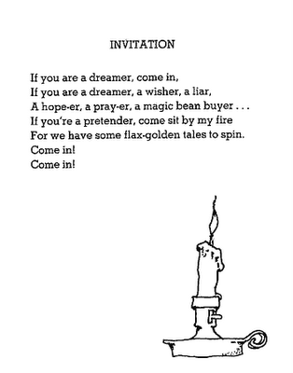
repetition
repeating of words,
lines, or phrases in a
poem in order to create
a pattern

Slide 15
rhythm
the flow of the beat in a poem; gives poetry a musical feel.

Slide 16
rhyme
words that end with
the same sound.

Slide 17
rhyme scheme
a pattern of end
rhymes in a poem

Slide 18
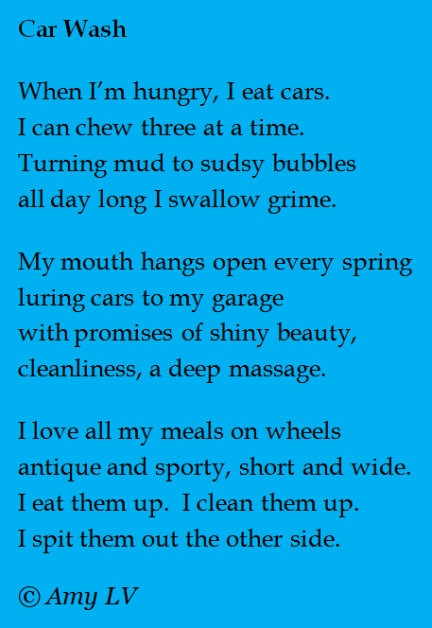
stanza
groups of two or more
lines that form a unit
of a poem

Slide 19
voice
the “narrator” or speaker in a poem. There can be one speaker or many.

