Slide 1
Types of Poetry
6th grade

Slide 2
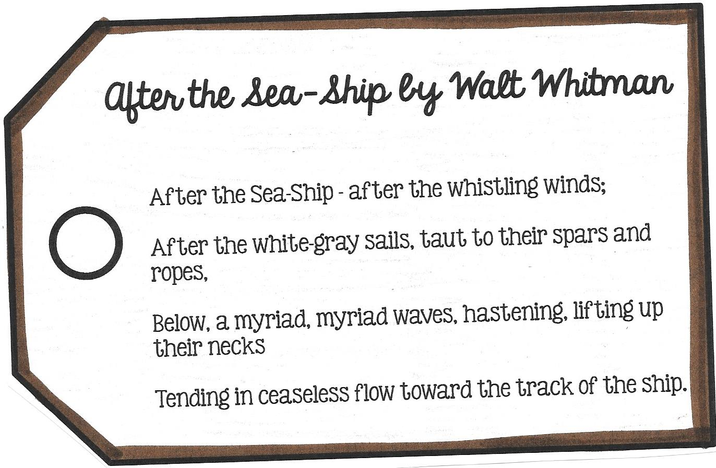
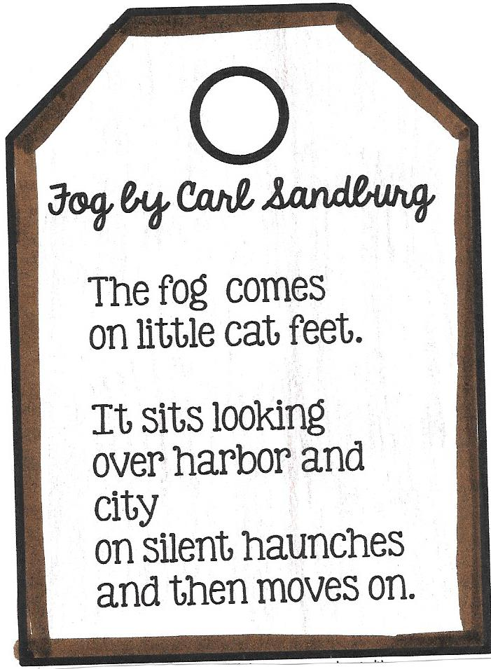
FREE VERSE
poetry that has no regular rhyme or structure

Slide 3
HAIKU
type of Japanese poetry
very short poem
17 syllables total 5/7/5
about nature or the seasons

Slide 5
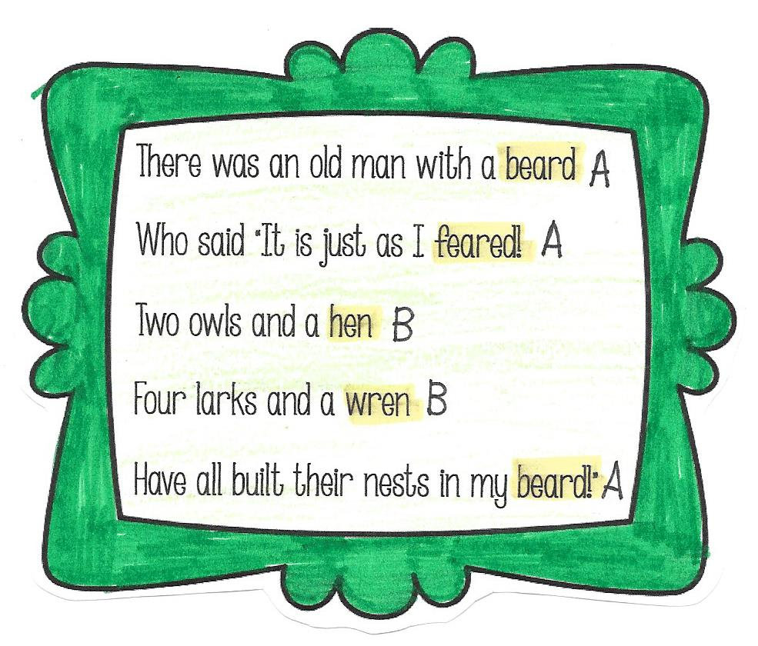
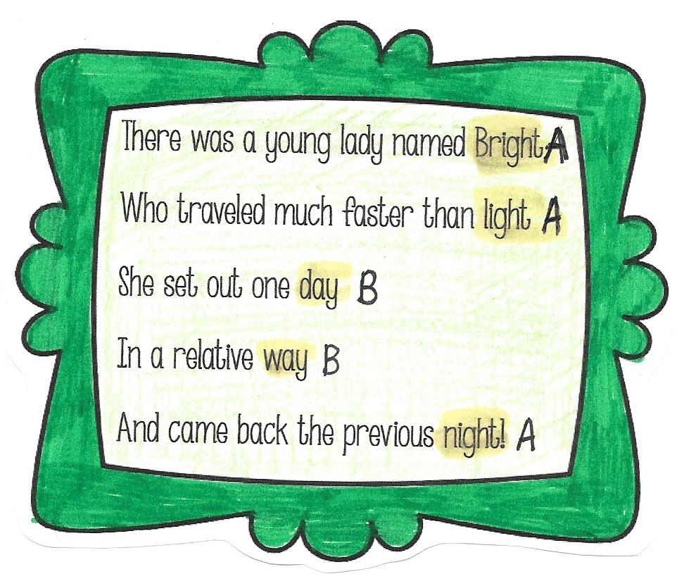
LIMERICK
meant to tell a funny story
have 5 lines
rhyme scheme AABBA

Slide 6
ODE
a poem that celebrates a subject
a tribute to an object, person, or event
can be serious or humorous
may or may not use rhyme or rhythm

Slide 7
ODE – Annotation Instructions
1. Highlight the last word of each line in yellow.
2. Annotate the rhyme scheme of the first two
stanzas by writing the letters to the right of the end rhyme.
3. Find the refrain. Underline the lines and put an R to left of each.
4. Find a metaphor in the first stanza and highlight it blue.
5. Find hyperbole in the second stanza.
6. Find an internal rhyme in the third stanza. Draw a rectangle around each of the rhyming words.

Slide 8
LYRIC POETRY
poetry that expresses the thoughts and
feelings of the writer or speaker
songlike quality or set to a beat
specific rhyming scheme

Slide 9
LYRIC POETRY
Directions:
1. Number the stanzas in the poem.
2. Highlight yellow the last word of each line.
3. Annotate the rhyme scheme of the first two
stanzas by writing the letters to the right of the end rhyme.
4. Underline the refrain in the poem.
5. Fold and glue this page in your notebook.

Slide 10
Annabel Lee Annotating Instructions
Highlight the end rhyme with a yellow highlighter.
Annotate the rhyme scheme by writing the letters to the right of each end rhyme.
Using a green crayon, highlight the personification in the second and fourth stanzas.
Using a purple crayon, highlight alliteration in the fourth and fifth stanzas.
Draw a rectangle around the internal rhymes in the last stanza. Find the internal rhyme in the fourth stanza, too.

Slide 11
NARRATIVE POETRY
A poem that tells a story.
Generally longer than the lyric styles of poetry b/c the poet needs to establish characters and a plot.

Slide 12
The Battle of New Orleans Annotation
Highlight the end rhyme with a yellow highlighter.
Annotate the rhyme scheme by writing the letters to the right of each end rhyme.
Using a purple colored pencil, highlight alliteration in the first, fifth, and eighth stanzas.
Circle the refrain in the poem with a blue colored pencil.

